Slide 1

Evaluations & NeoEd Perform - Supervisors
February 10 & 11, 2026

Slide 2
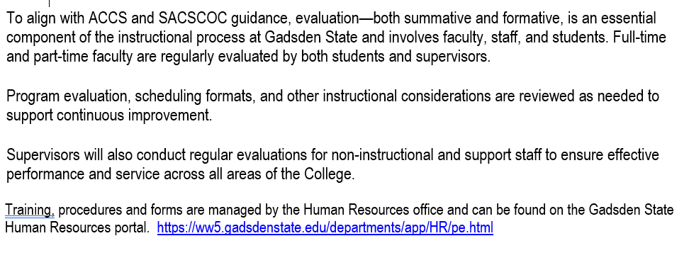
Evaluation Procedures – F/8.5

Slide 3
TimeLine
Employee Parts
NeoEd Evaluation
Supervisor’s Supervisor
Submit Signatures
Final Reviews
Due March 6
March 31
April 30
May 30
Final Due June 30

Slide 4
Components of the Evaluation
Full Time Faculty & Staff
  1. Complete Resume Template (new - required this year)
  2. Review Job Description (new – required this year)
  3. Employee Evaluation Form (PD, Previous Goals, PD Goals coming year)
  4. Self Assessment Form – May be Optional – Check with your Supervisor
  5. Upload All Forms to NeoEd
  NeoEd Process same as last 2 years (Supervisor completes in NeoEd).

Slide 5
Components of the Evaluation
Part-Time Faculty (Adjunct / Dual Enrollment)
  1. Complete the Resume Template (new - required this year)
  2. Job Description Review (new – required this year – may be generic)
  3. Employee Evaluation Form (PD, Previous Goals, PD Goals coming year)
  4. Self Assessment Form – May be Optional – Check with your Supervisor
  5. Upload All Forms to NeoEd (NEW)
  New - Your supervisor will complete your evaluation in NeoEd and upload your classroom or online observation and submit to you for your signature.

Slide 6
Components of the Evaluation
Part-Time Staff / Clinical
  1. Complete Resume Template (new - required this year)
  2. Job Description Review (new – required this year - may be generic)
  3. Complete Self Assessment Form – Required. Send your Self Assessment to your Supervisor email
  4. Upload 1 – 2 in NeoED (NEW)
  5. Your Supervisor will complete their part & upload to NeoEd
  No NeoEd Signatures Required

Slide 7
Components of the Evaluation
COACHES
  1. Complete the Resume Template
  2. Job Description Review – could be generic
  3. Self Assessment Form - Optional
  4. Upload Forms 1 – 3 to NeoEd
  5. Supervisor will upload Coaches assessment to NeoEd
  No NeoEd signatures required

Slide 8
Optional Employee Evaluation of Supervisor
Email to jobs@gadsdenstate.edu or upload to NeoEd

Slide 9
My Gadsden State Page - Forms
Log onto the My Gadsden State page using the following URL
https://ww5.gadsdenstate.edu/departments/app/HR/pe.html
Everything can be found there
MyGadsdenState>Departments>Human Resources>Performance Evaluations

Slide 10
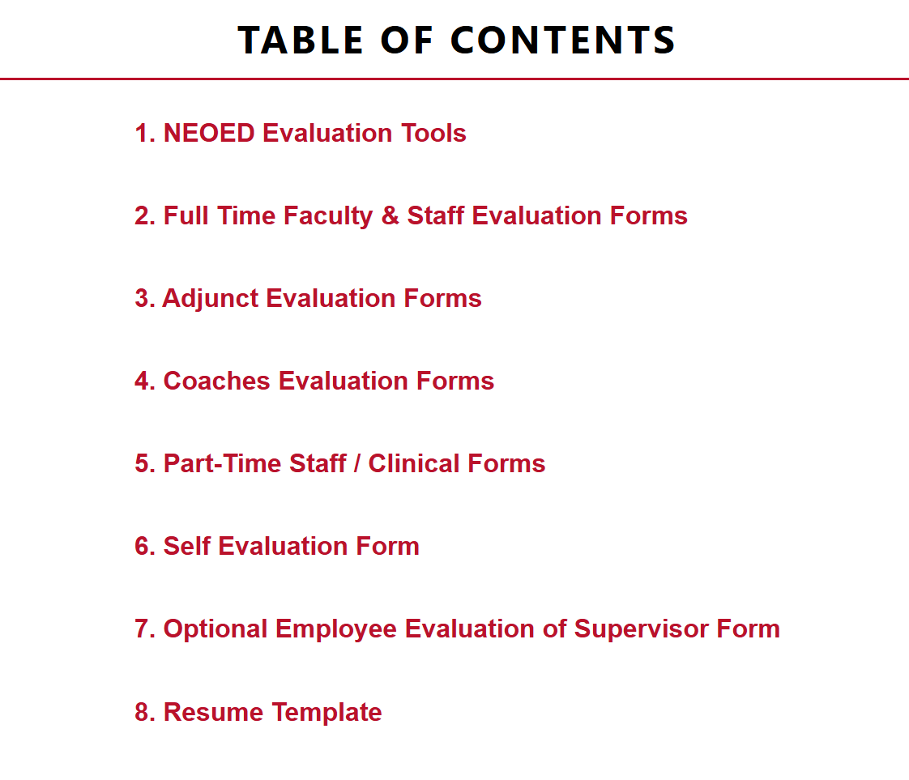
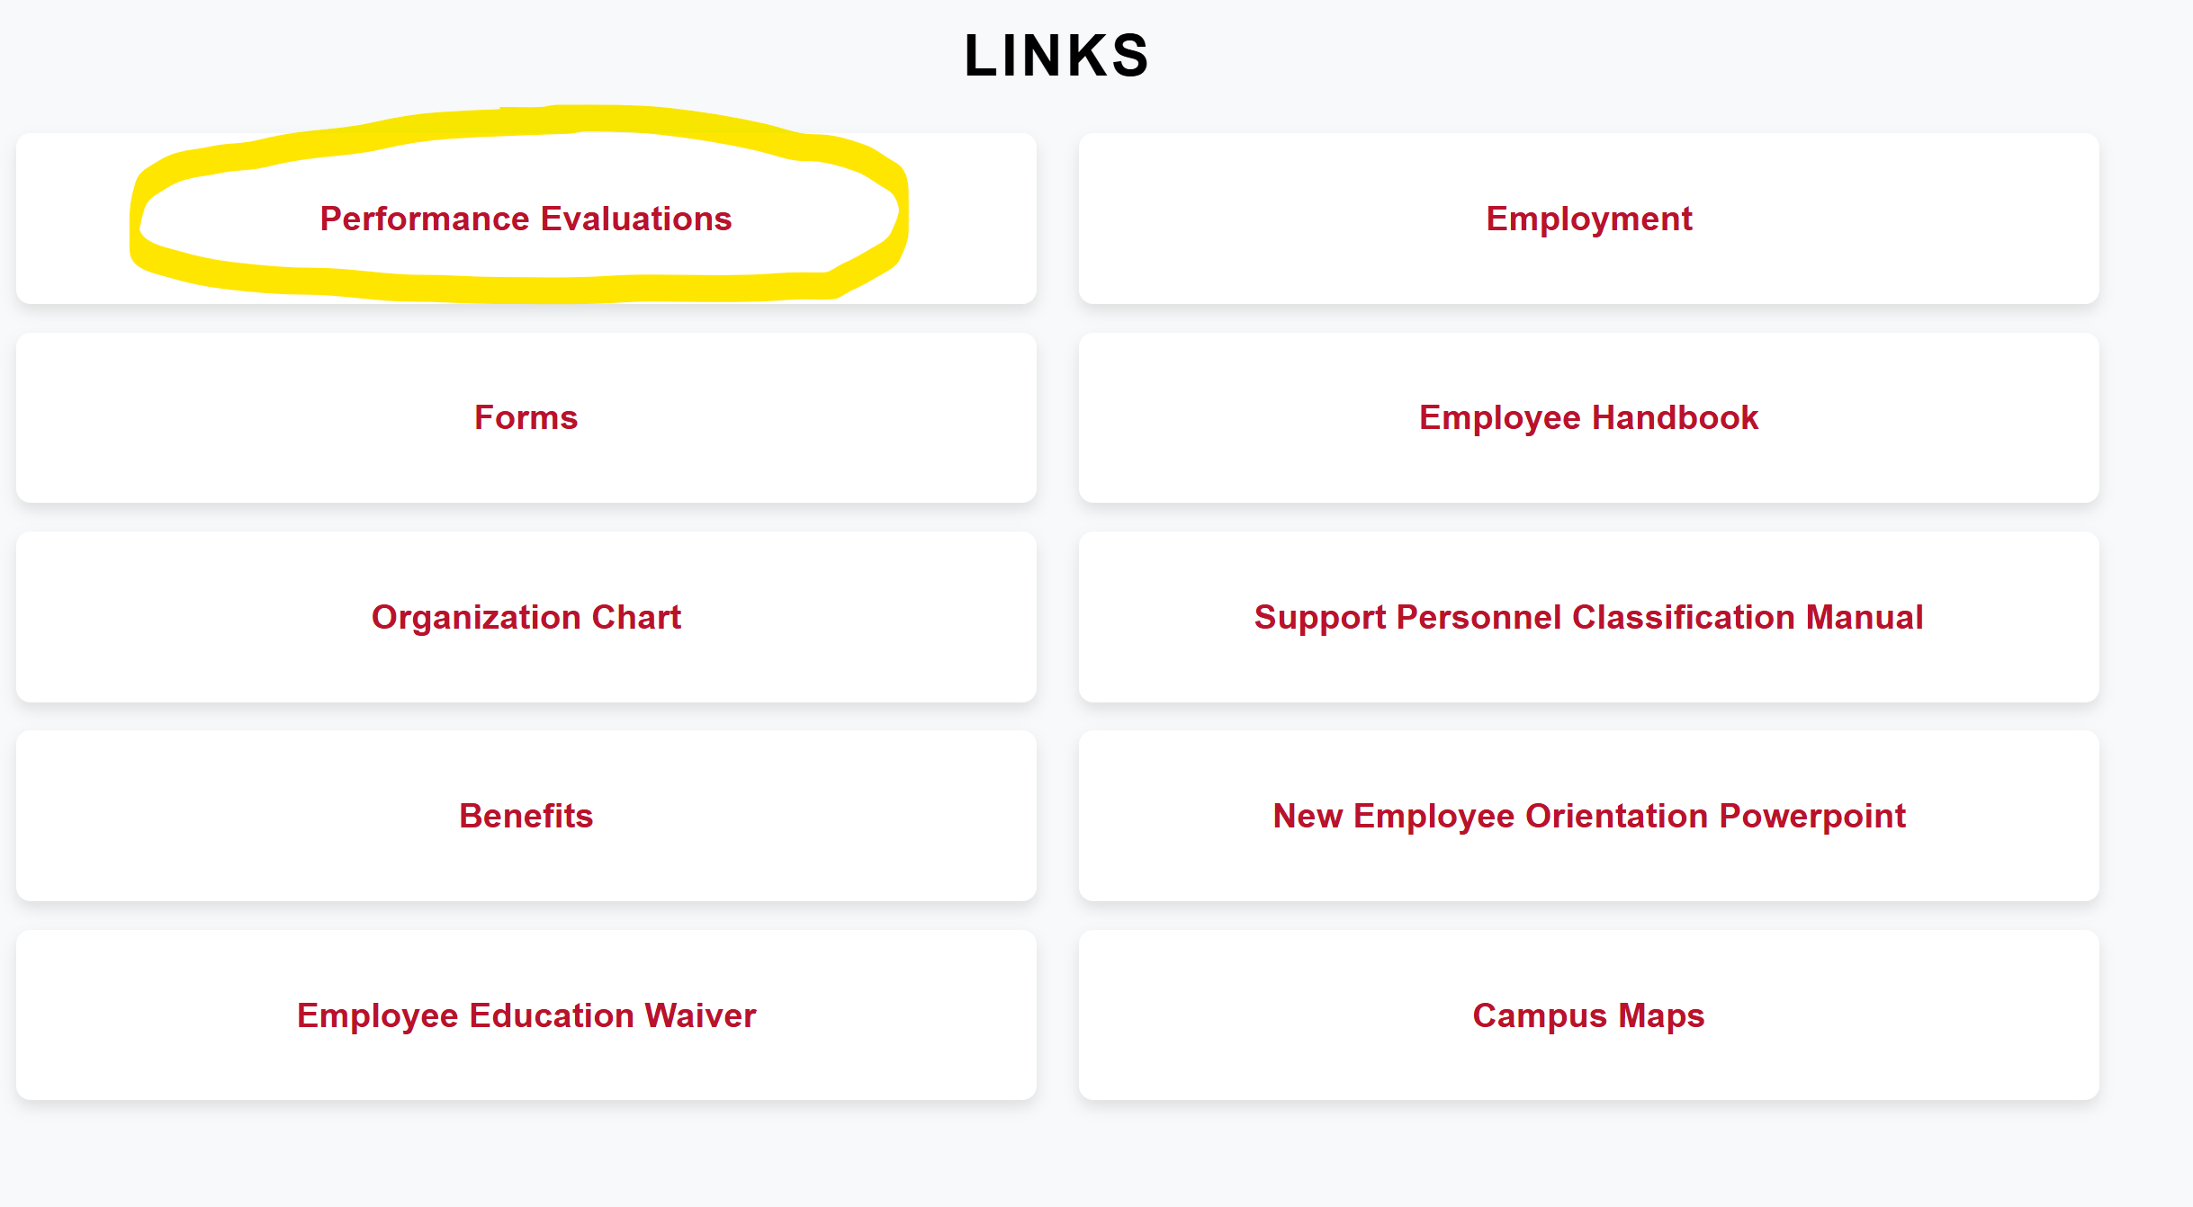
My Gadsden State Page - Forms

Slide 11
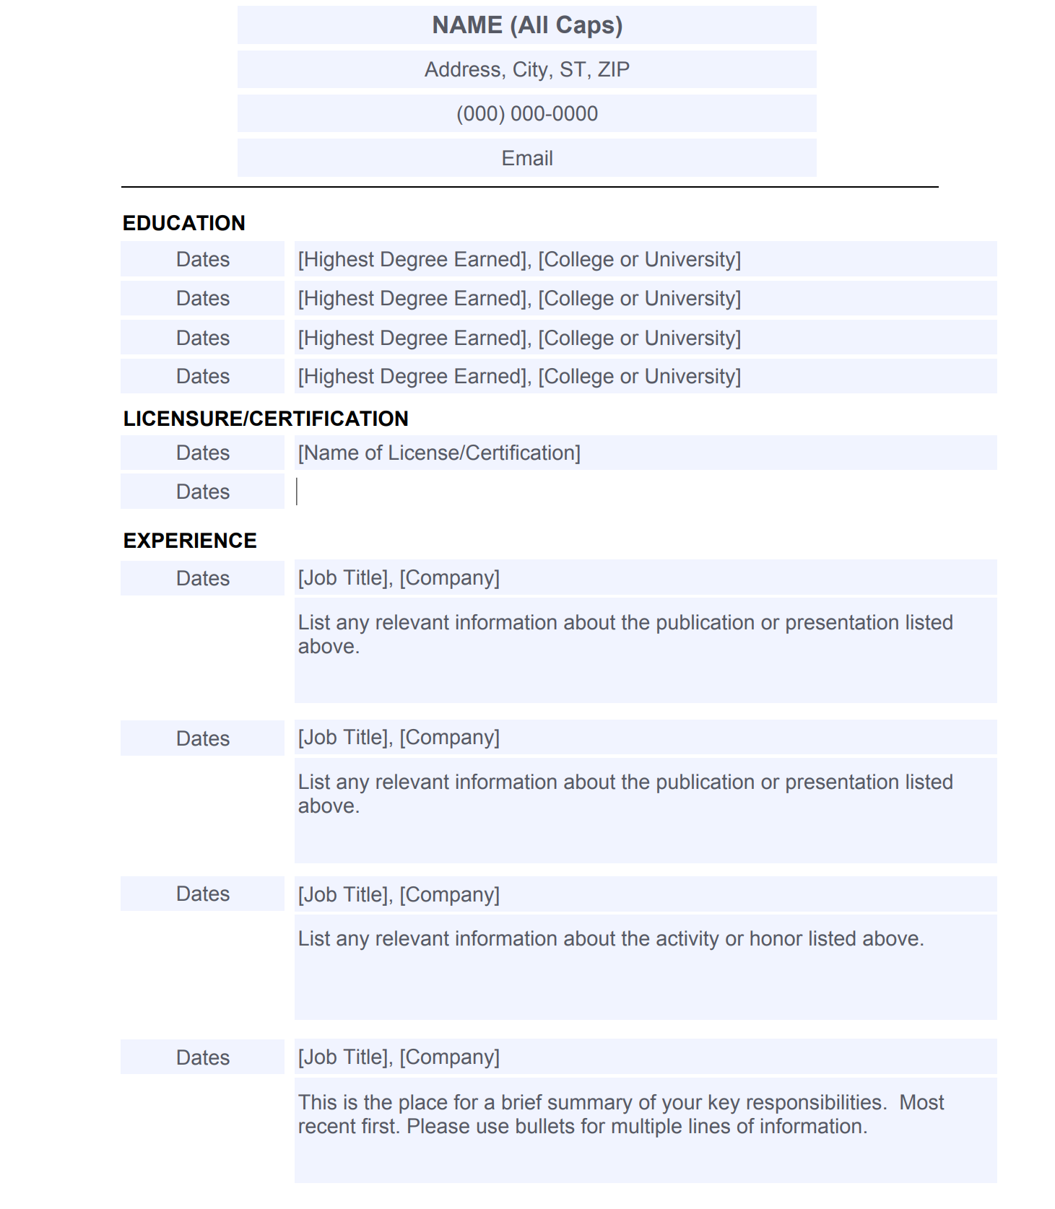
Resume
Complete it.
1
File Save With Changes to your computer
2
Last NameFirstName 022026
Upload it to NeoEd Perform by March 6 via the ‘Upload Document’ tool
3

Slide 12
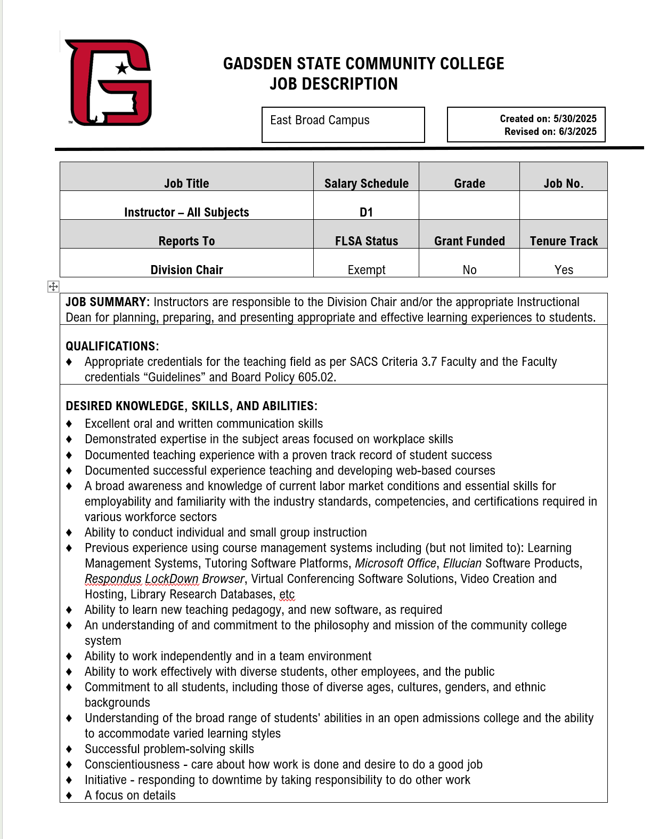
Job Description
MyGadsdenState>Departments
HumanResources>Performance Evaluations>
Job Descriptions
Search
Upload it to NeoEd Perform by 3/6 via the ‘Upload Document’ tool

Slide 13
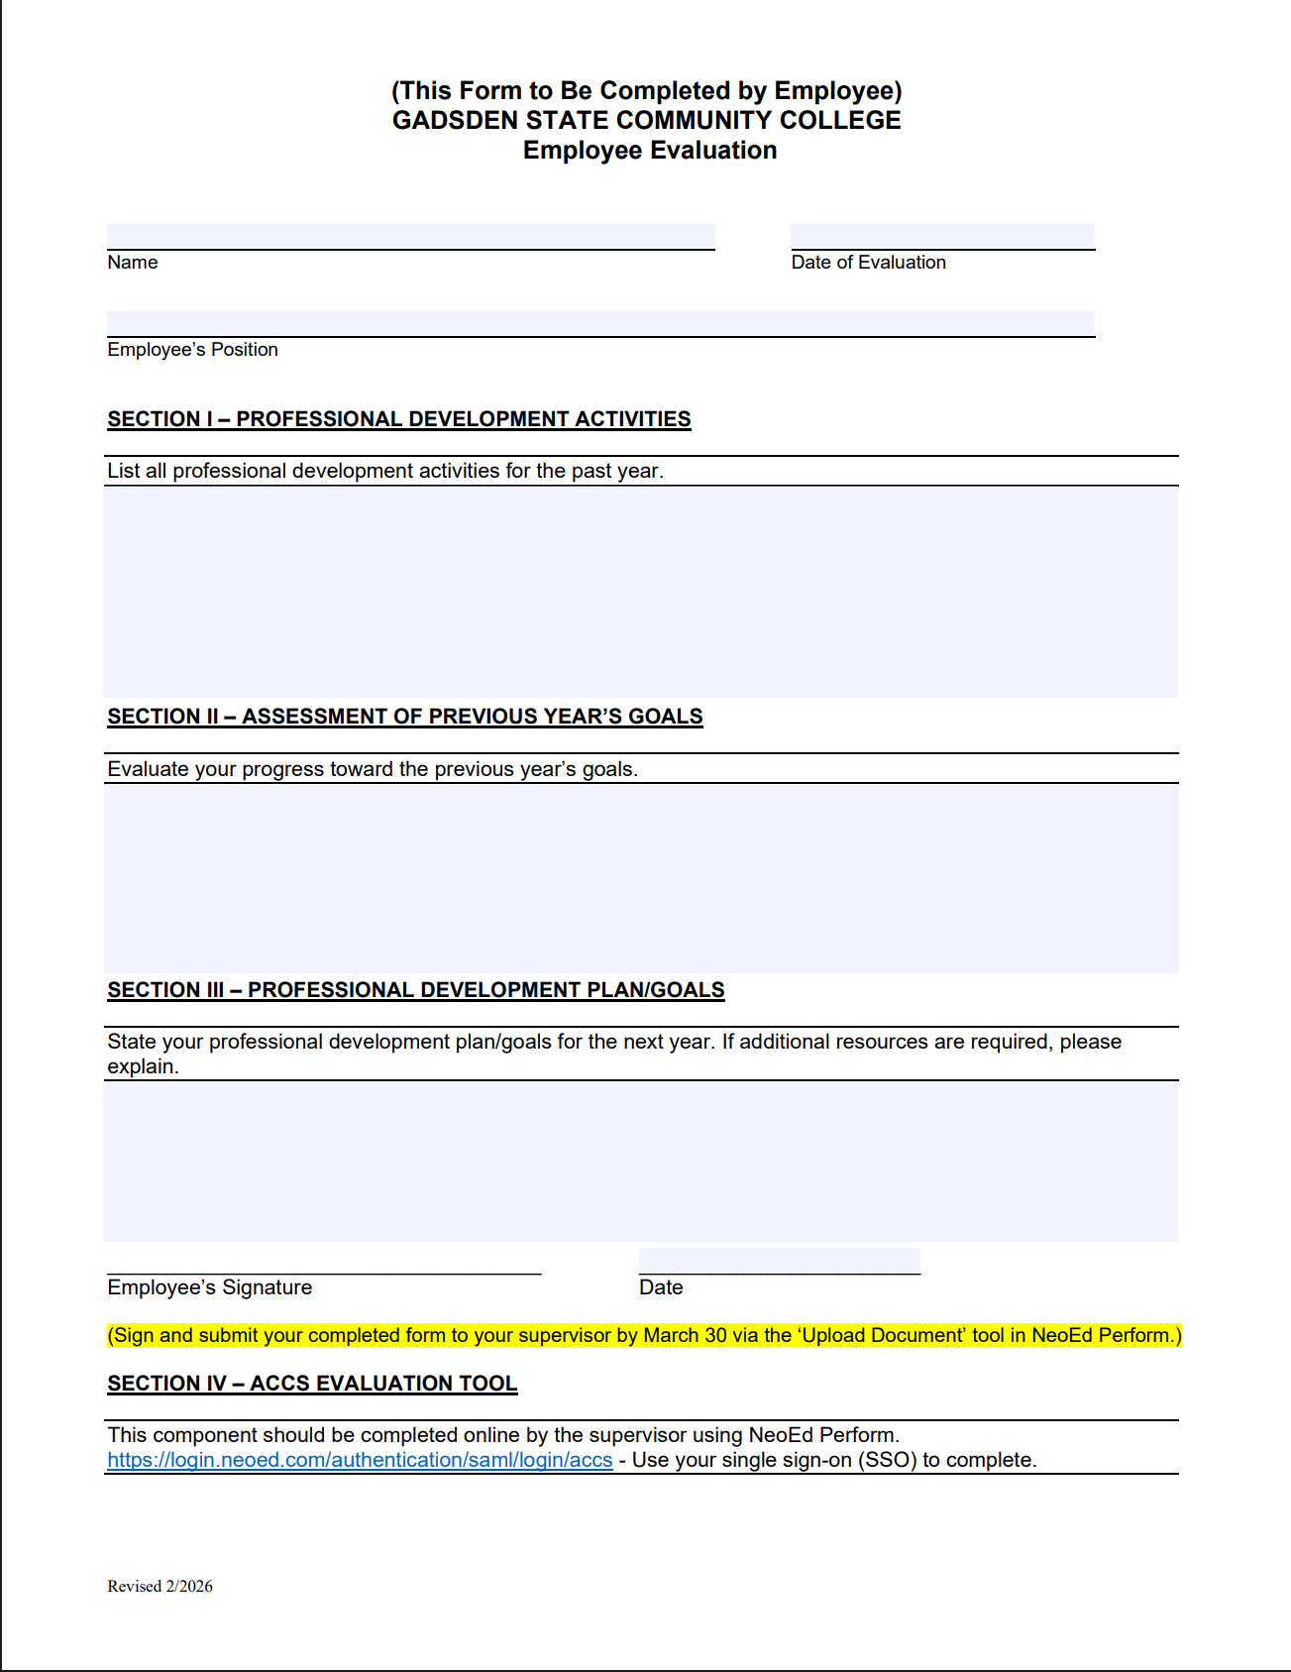
Evaluation Form
Section I – PD Activities from last year
Section II – Assessment of Previous Year’s Goals
Section III – PD Plan / Goals for next year
Sign / Date - May be filled in or digitally signed
Upload it to NeoEd Perform by 3/6 via the ‘Upload Document’ tool

Slide 14
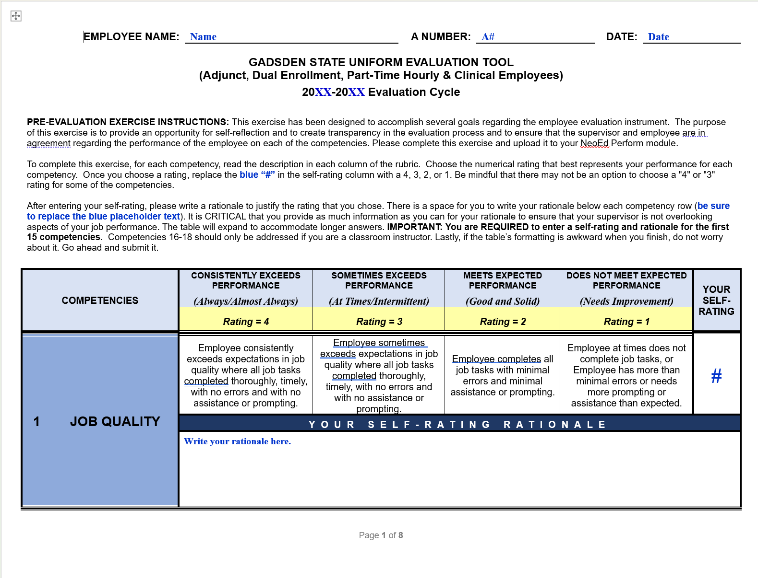
Self Assessment
Complete it
Save it as LastName First Name 032026
Upload to NeoEd Perform by March 6
Required for Part-Time Staff / Clinical

Slide 15
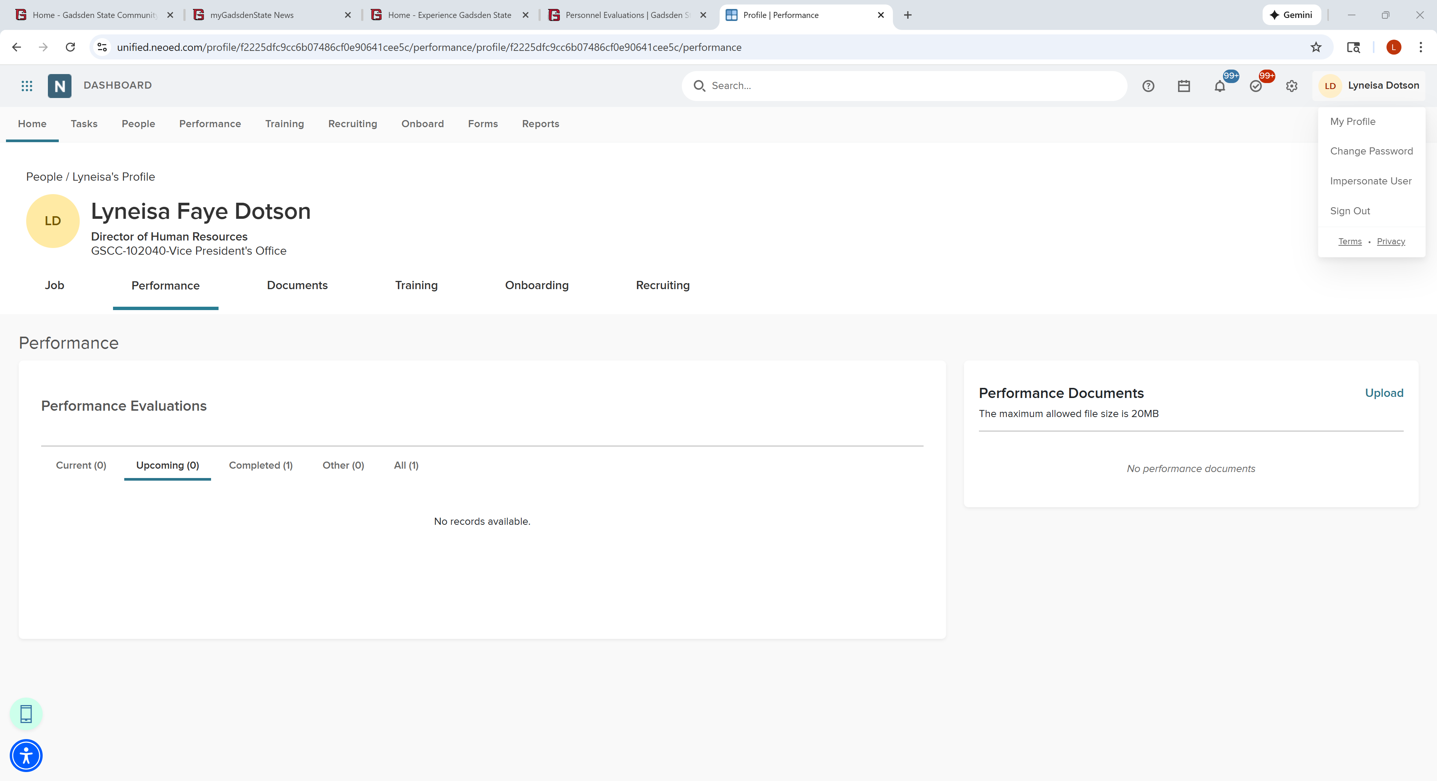
Upload Your Form to NeoEd
Click in the top right corner on your name and then ‘My Profile’
Click on the ‘Performance’ Tab
Upload your completed evaluation form to NeoEd by 5/31 via the ‘Upload’ tool
1
2
3

Slide 16
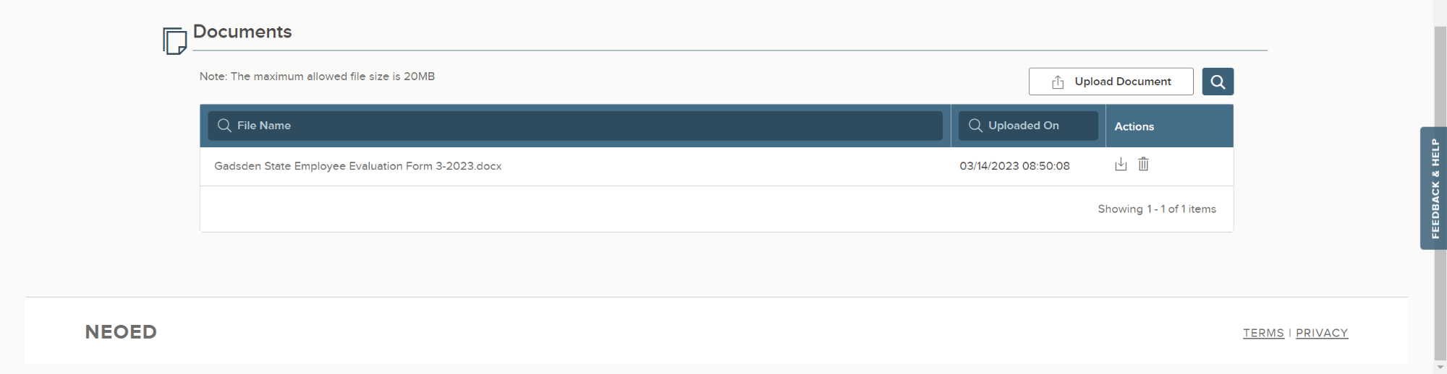
Check Your Work
Scroll to the bottom of the screen and look for the ‘Documents’ section
Look to make sure your attachment was uploaded.

Slide 17
Final Steps
Once your supervisor has completed the ACCS rating tool in NeoEd Perform, you will receive a notification
1
You will log back into NeoEd Perform to view your rating
2
Acknowledge
Refuse to Sign

Slide 18
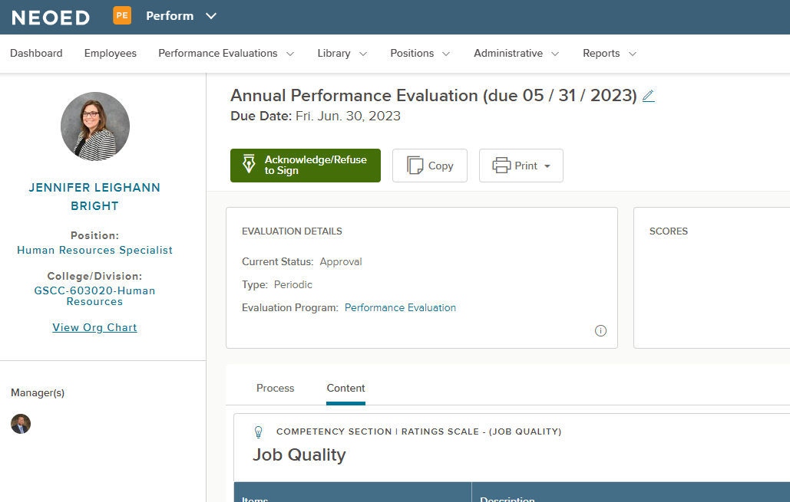
Final Steps
You may click the link from your email to view your rating in NeoEd.
From NeoEd, click the green ‘Acknowledge/Refuse to Sign’ button to advance to the comments section.

Slide 19
Supervisors

Slide 20
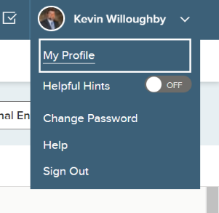
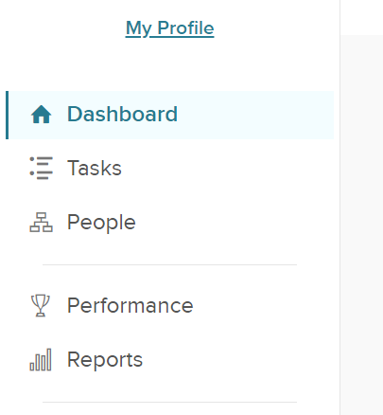
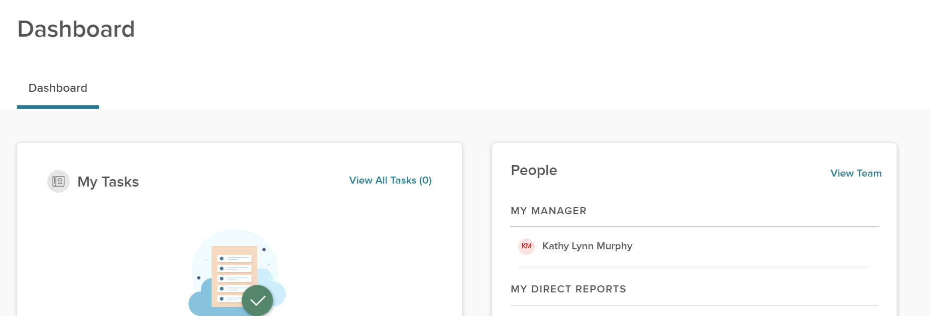
Supervisor Tasks
Check your portion of the org chart to ensure all of your full-time direct reports are listed
Click your name in the top right corner, then ‘My Profile’ and then click ‘Dashboard’ in the left pane and look for the ‘People’ section and ‘View Team’
1
2
3

Slide 21

Supervisor Tasks
Complete the ACCS Rating Tool in NeoEd
Electronic signatures by supervisor + supervisor’s supervisor
Send to employee for acknowledgement (in NeoEd)
For faculty only: Upload the Classroom Observation form to NeoEd Perform via the ‘Upload Document’ tool
You’ll receive a notification from NeoEd when the employee has completed the acknowledgement

Slide 22
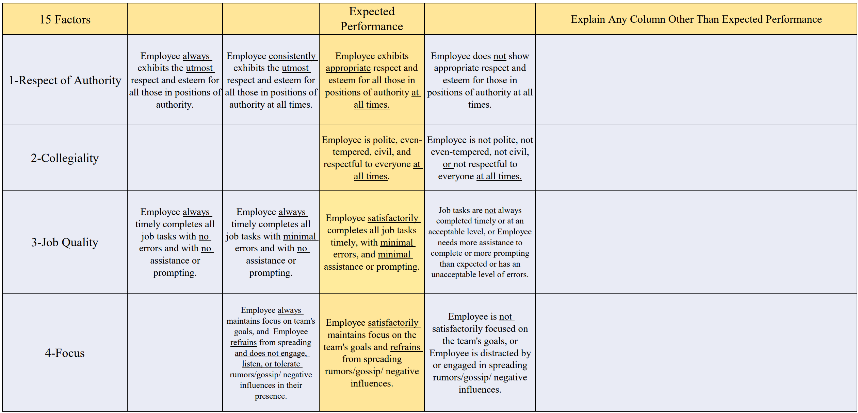

Slide 23
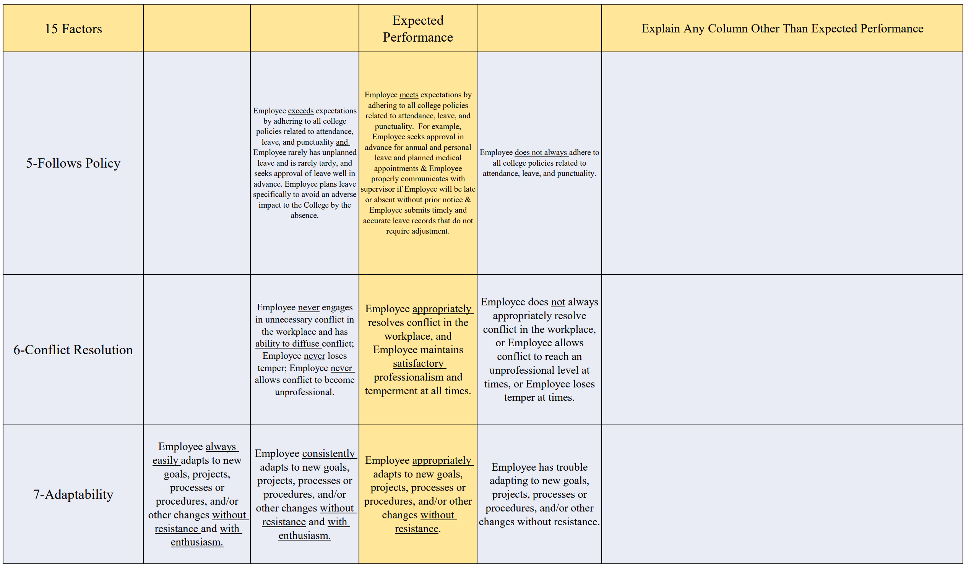

Slide 24
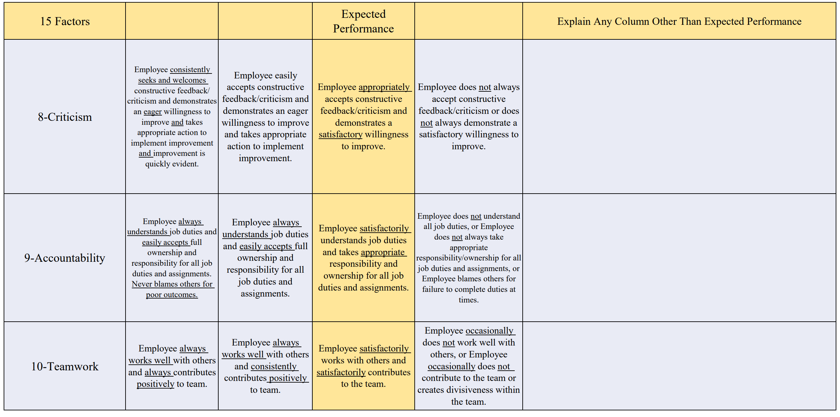

Slide 25
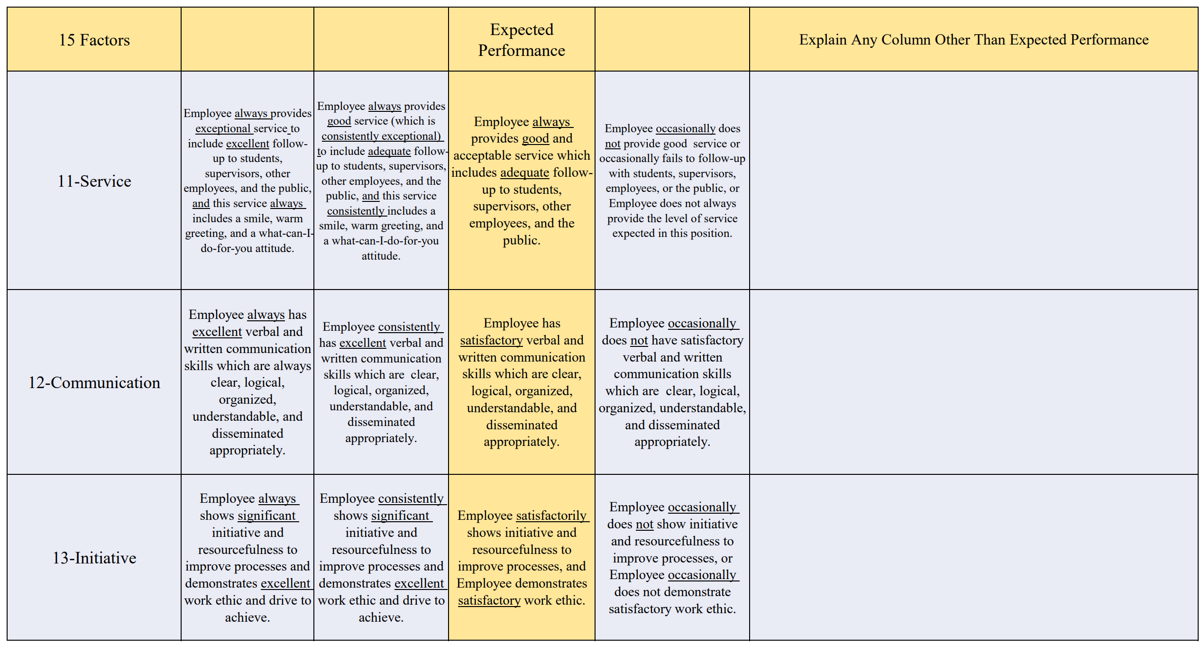

Slide 26
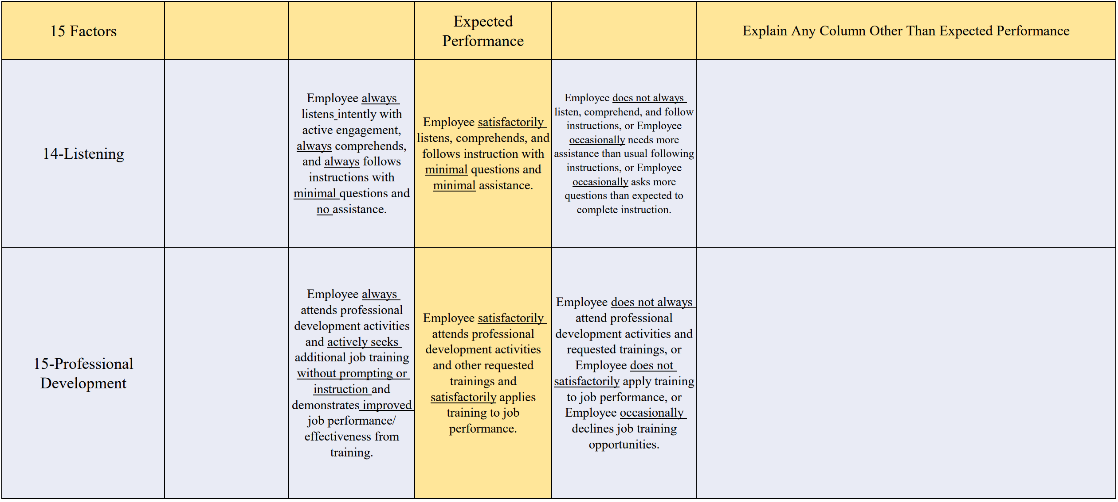

Slide 27
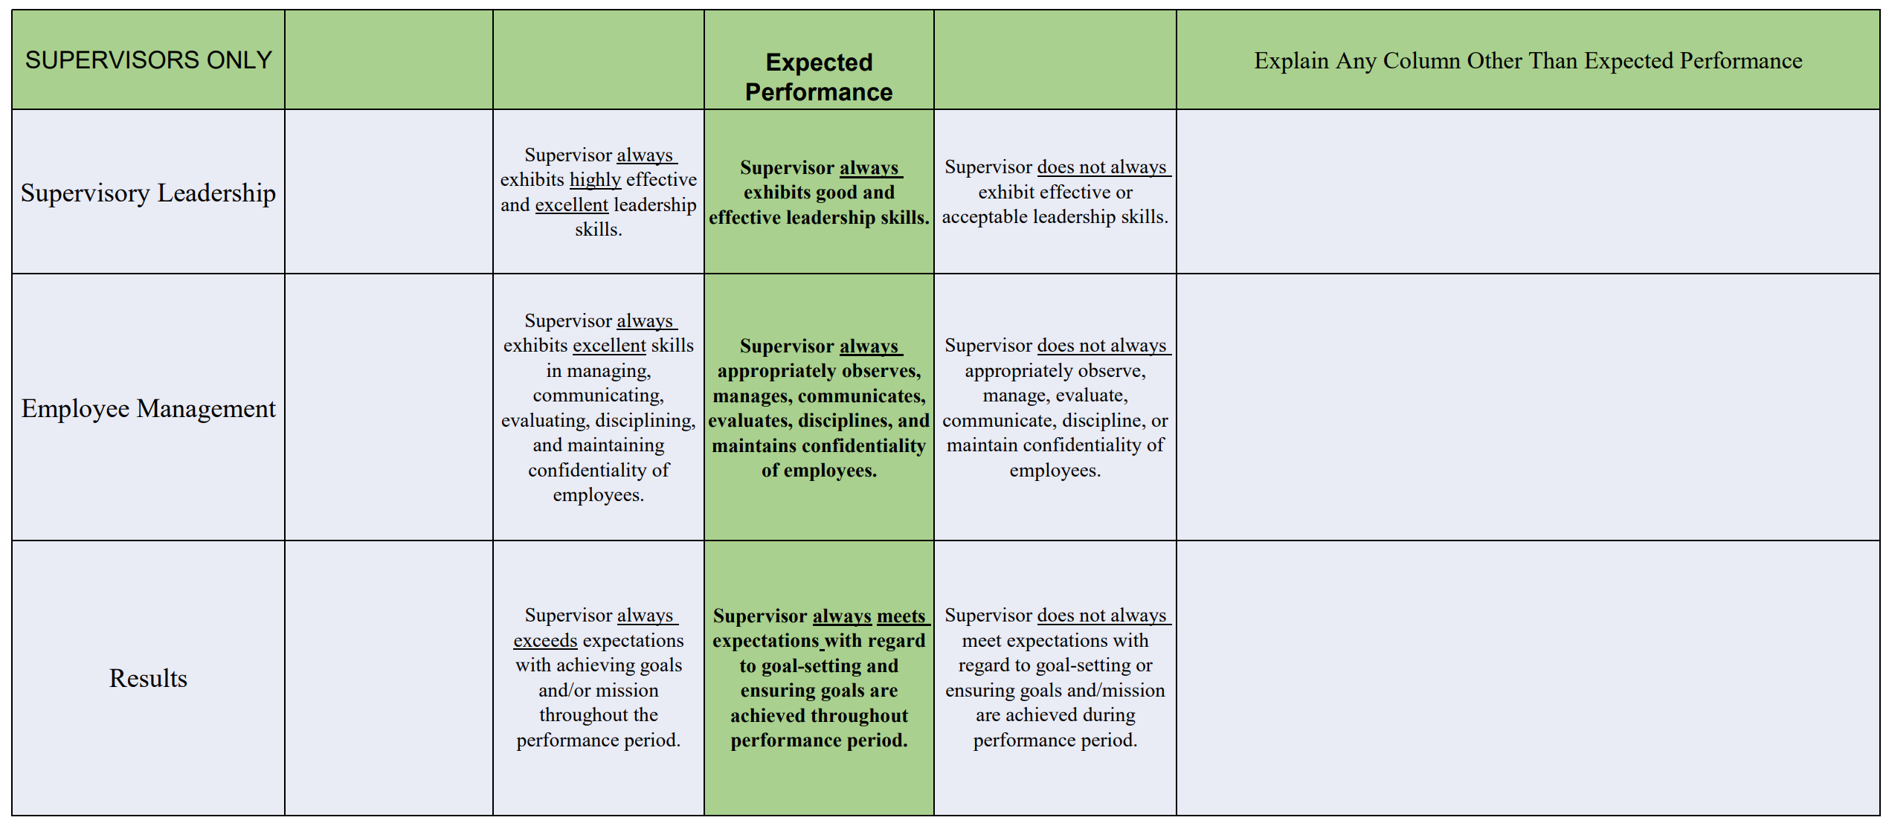

Slide 28
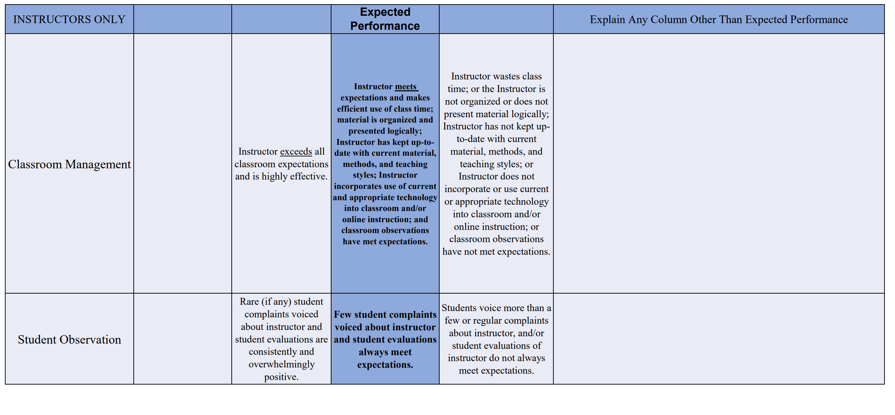

Slide 29
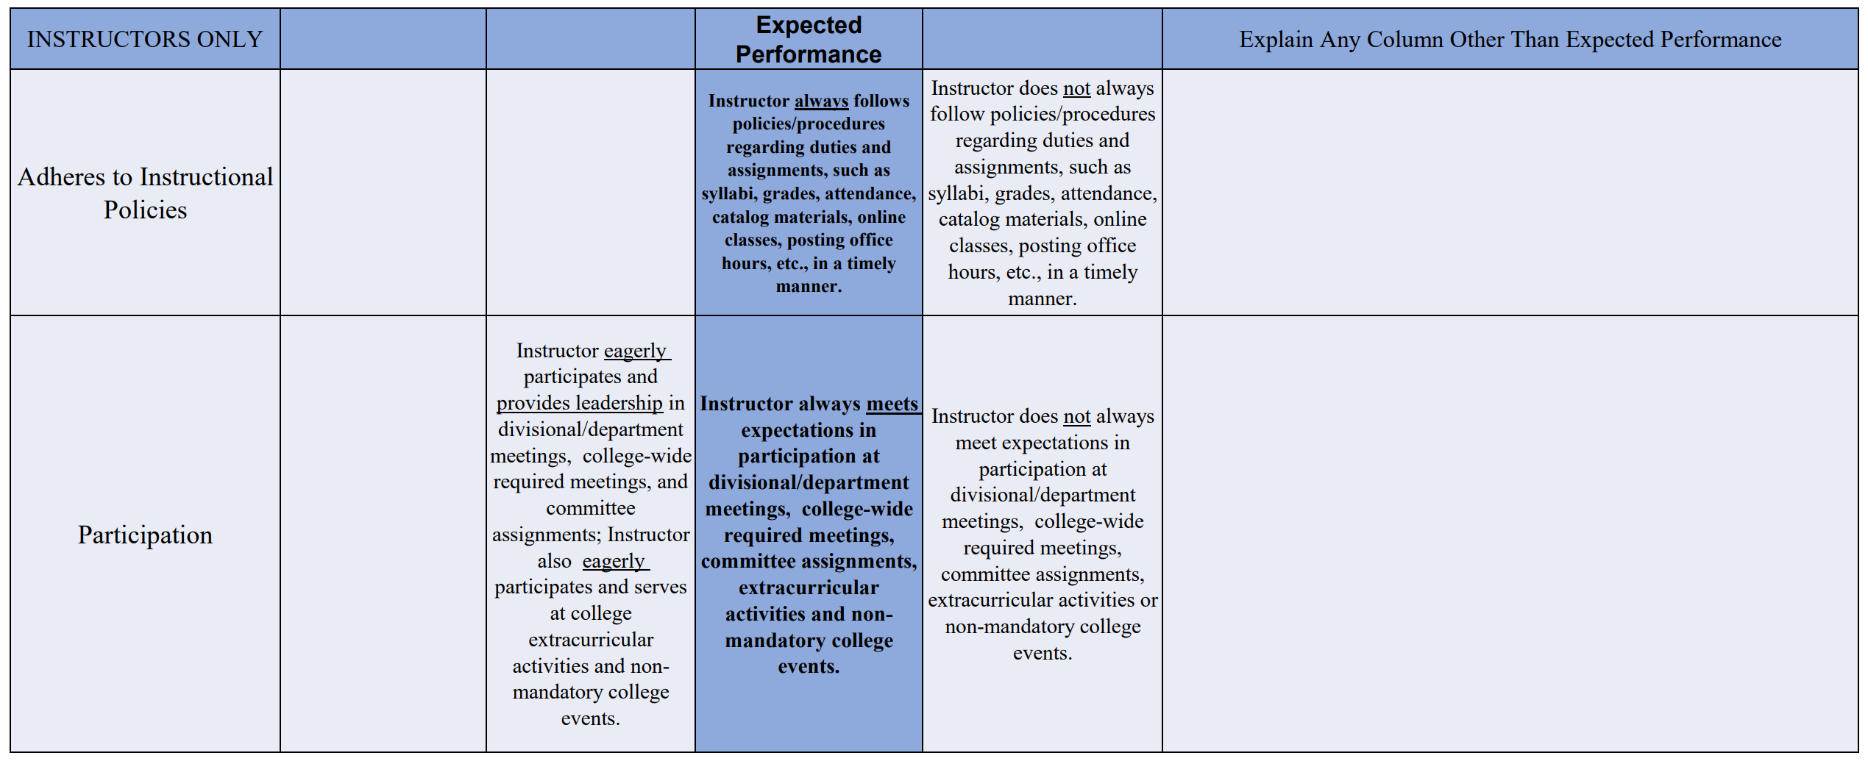

Slide 30
Scoring Employees
General Rule
If you are uncertain or cannot decide between two different blocks, mark the lower option (or block to the right).
15 Factors |  |  | Expected Performance
Criticism | Employee consistently seeks and welcomes constructive feedback/ criticism and demonstrates an eager willingness to improve and takes appropriate action to implement improvement and improvement is quickly evident. | Employee easily accepts constructive feedback/criticism and demonstrates an eager willingness to improve and takes appropriate action to implement improvement. | Employee appropriately accepts constructive feedback/criticism and demonstrates a satisfactory willingness to improve. | Employee does not always accept constructive feedback/criticism or does not always demonstrate a satisfactory willingness to improve.

Slide 31
Evaluating Employees
Supervisors MUST give REAL and DESERVED marks to employees.
Supervisors will be required to provide comments (examples) for any marks above or below standard.
Giving everyone the highest mark in every category is NOT helpful (unless the employee truly meets the criteria stated).
Everyone can improve their performance in some way.
Provide feedback like a coach & mentor, not a judge.

Slide 32
Supervisor Tips
It is a good practice to document for yourself both good and bad performance/conduct during the entire performance period.
It is a good practice to also notify employees of these good and bad points as well.
Bad points should always be conveyed in person and in private.
Employees should not really hear about their good or bad points for the first time at evaluation time. (The goal is to discuss them at the time they happen so that there are no surprises at evaluation time).
These notes will be very helpful to you when filling out the evaluation tool.

Slide 33
Annual Performance Reviews
Schedule Face-to Face Meetings.
Supervisors must have a face-to-face, sit down, private meeting, with all employees under your supervision.
These meetings should take anywhere from 15 minutes to an hour.
These are conversations, not presentations or lectures.
Employees should be able to talk and provide feedback as well.
Employees are expected to remain calm and professional. Supervisors even more so.
Suggest you provide evaluation to employee in advance of meeting so that the employee can digest the contents prior to the discussion. (Can remove much emotion and drama from meeting).
Avoid conversations where everything discussed in the meeting involves positive and negative recent events. Recent events color your judgment of the employee’s performance.
Supervisors are responsible to document positive occurrences such as completed projects, and negative occurrences such as a missed deadline, during the entire year.
Keep the review simple. Prioritize and comment only on main points.

Slide 34
Difficult Employees
Supervisors must professionally deal with difficult employees
Supervisors should allow employees time to speak and afford employees the ability to be critical of the supervisor (provided the communications are in a reasonably professional manner)
Supervisors should know that employees have the ability to “rebut” or “respond” to evaluation elements that they do not agree with. They are placed with evaluations in employee files.
Allowing difficult employees this outlet often alleviates prolonged discussions regarding the evaluation.

Slide 35
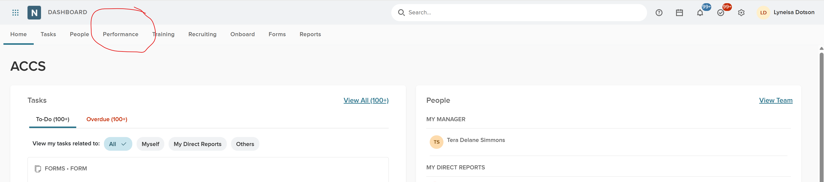
Entering Goals In NeoEd
Login to NeoEd – Click on Performance

Slide 36
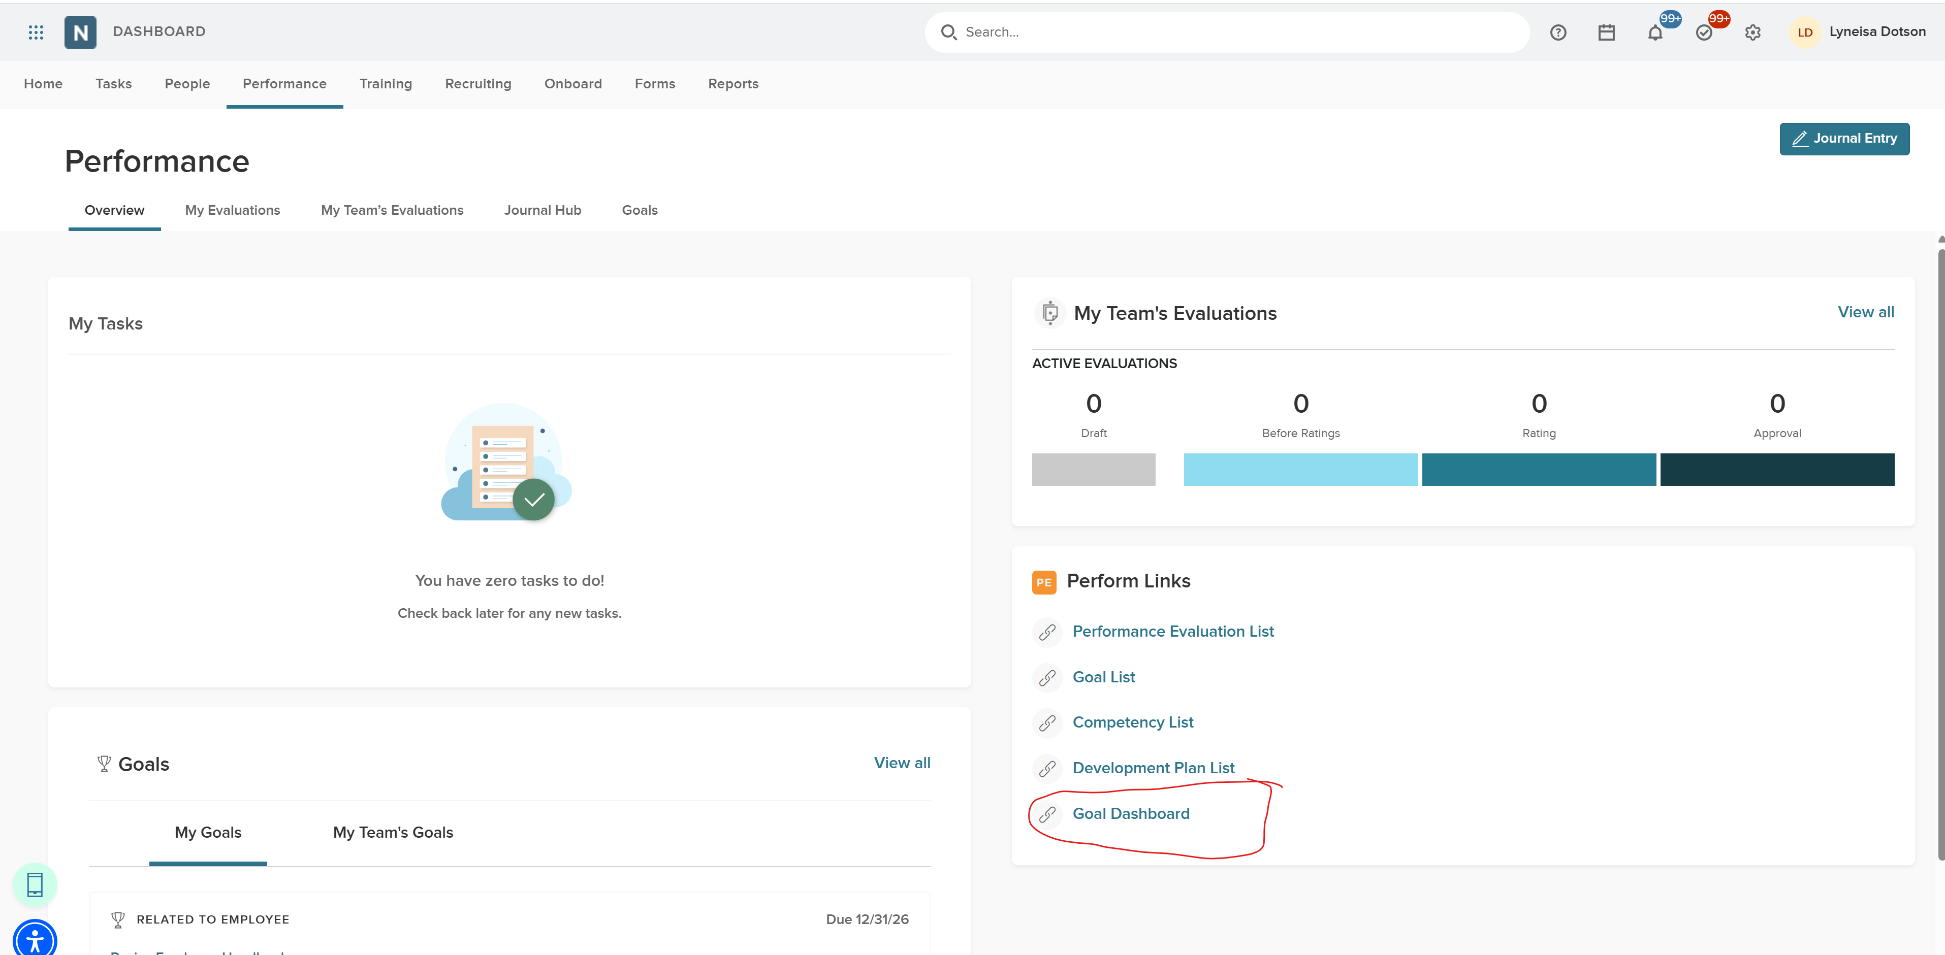
Entering Goals In NeoEd
Click on Goal Dashboard

Slide 37
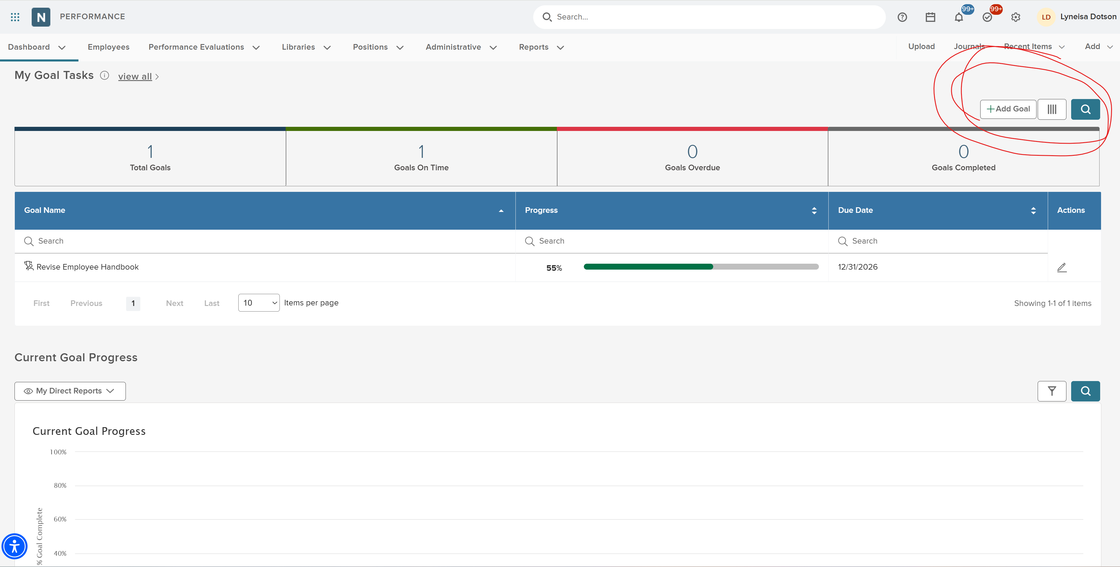
Entering Goals In NeoEd
You Can View your Goals / Direct Reports - +Add Goal

Slide 38
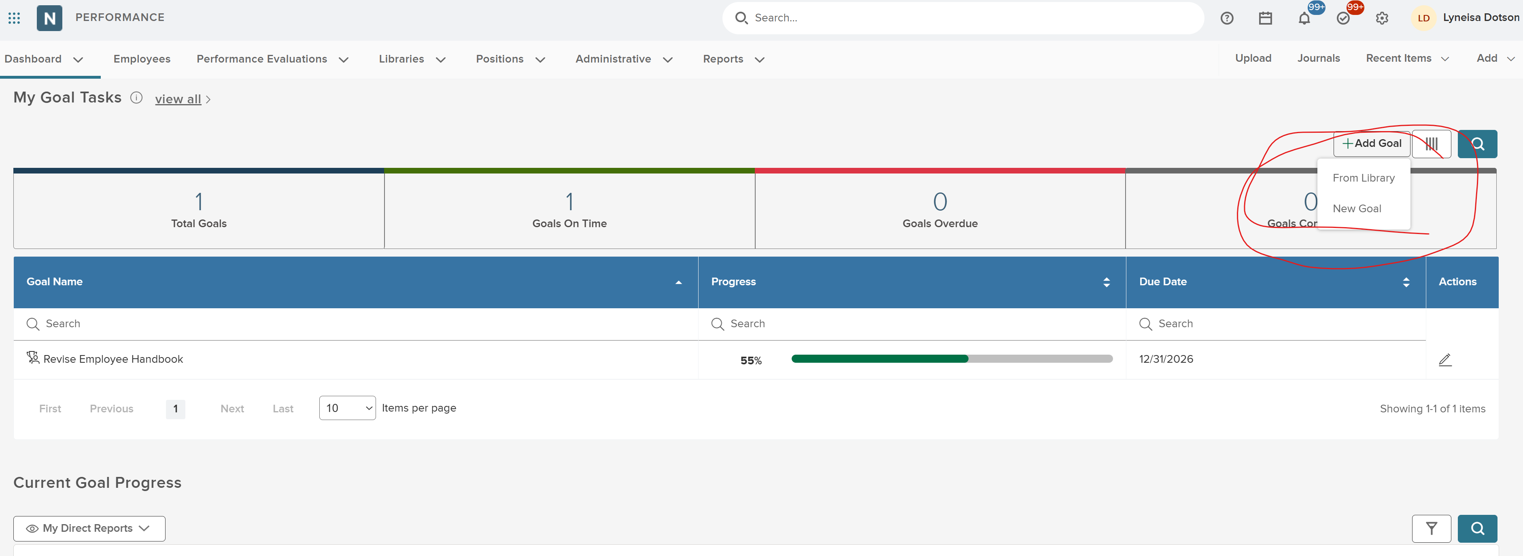
Entering Goals In NeoEd
Add New Goal or From Library

Slide 39
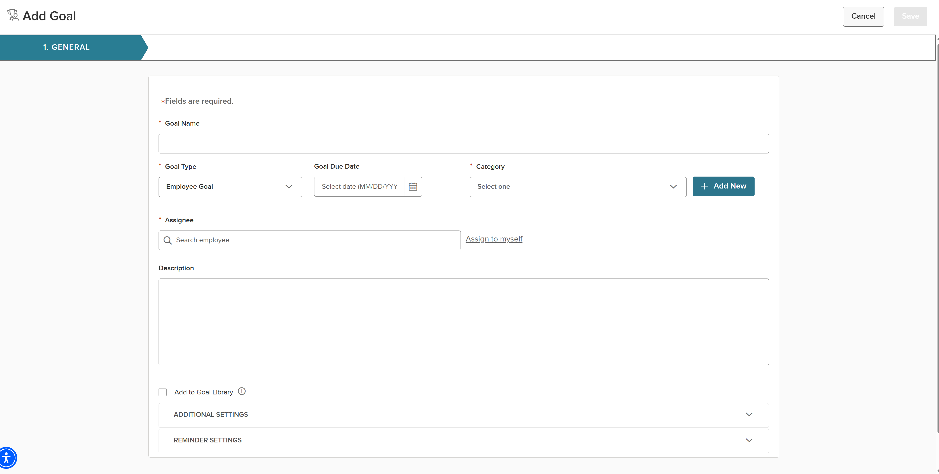
Entering Goals In NeoEd
Add New Goal View

Slide 40
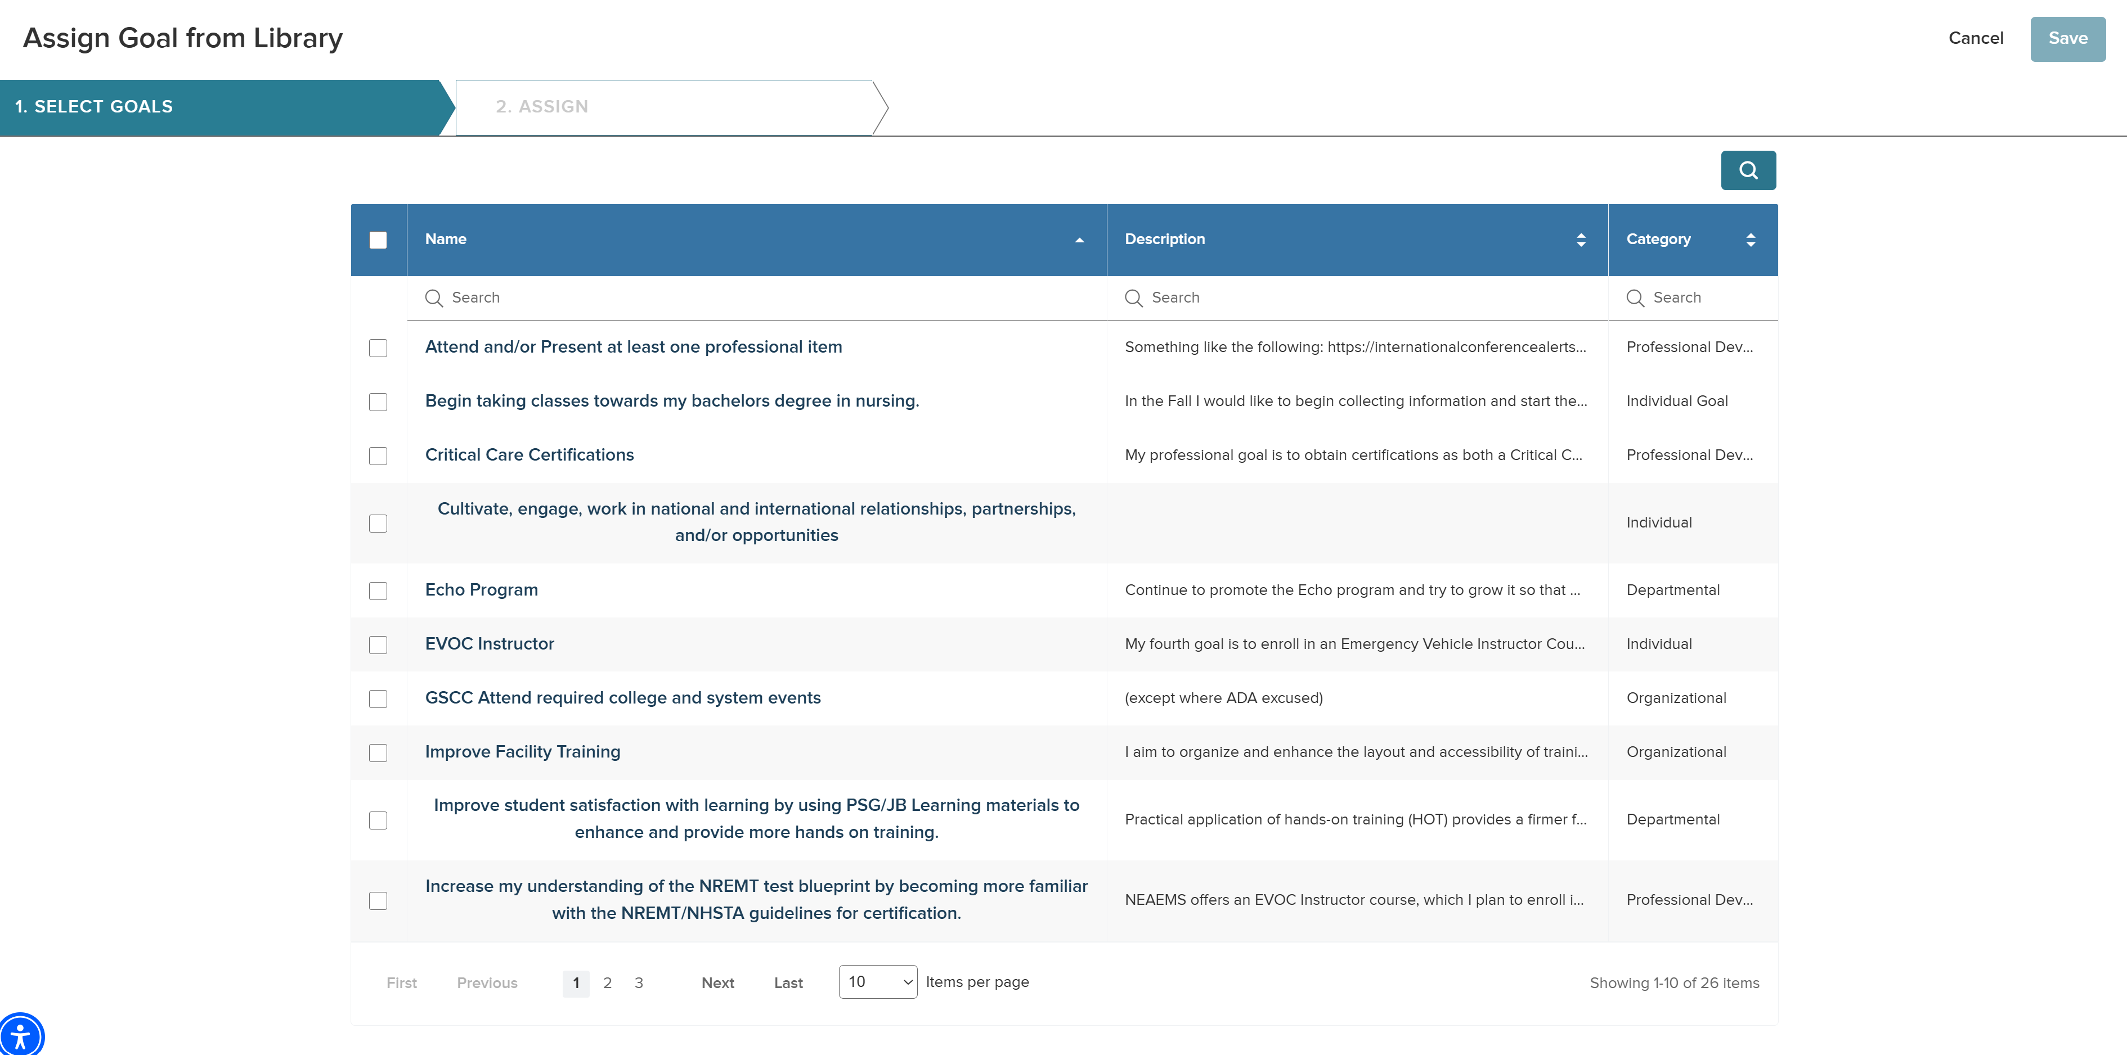
Entering Goals In NeoEd
Add From Library – You can Search by Keyword

Slide 41

Questions

