Slide 1

Evaluations & NeoEd Perform - Employees
February 10 & 11, 2026

Slide 2
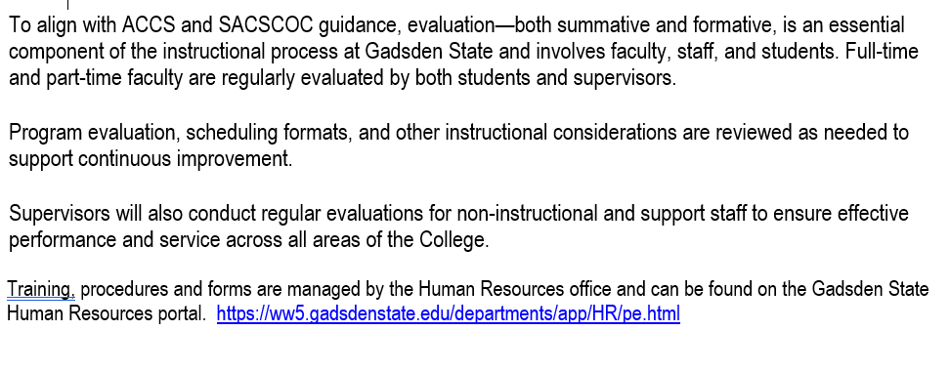
Evaluation Procedures – F/8.5

Slide 3
Our Part – Due March 6
Goal - One part per week
Due March 6

Slide 4
Components of the Evaluation
Full Time Faculty & Staff
1. Complete Resume Template (new - required this year)
2. Review Job Description (new – required this year)
3. Employee Evaluation Form (PD, Previous Goals, PD Goals coming year)
4. Self Assessment Form – May be Optional – Check with your Supervisor
5. Upload All Forms to NeoEd
NeoEd Process same as last 2 years (Supervisor completes in NeoEd).

Slide 5
Components of the Evaluation
Part-Time Faculty (Adjunct / Dual Enrollment)
1. Complete the Resume Template (new - required this year)
2. Job Description Review (new – required this year – may be generic)
3. Self Assessment Form – May be Optional – Check with your Supervisor
4. Employee Evaluation Form (PD, Previous Goals, PD Goals coming year)
5. Upload All Forms to NeoEd (NEW)
New - Your supervisor will complete your evaluation in NeoEd and upload your classroom or online observation and submit to you for your signature.

Slide 6
Components of the Evaluation
Part-Time Staff / Clinical
1. Complete Resume Template (new - required this year)
2. Job Description Review (new – required this year - may be generic)
3. Complete Self Assessment Form – Required. Send your Self Assessment to your Supervisor email
4. Upload 1 – 2 in NeoED (NEW)
5. Your Supervisor will complete their part & upload to NeoEd
No NeoEd Signatures Required

Slide 7
Components of the Evaluation
COACHES
1. Complete the Resume Template
2. Job Description Review – could be generic
3. Self Assessment Form - Optional
4. Upload Forms 1 – 3 to NeoEd
5. Supervisor will upload Coaches assessment to NeoEd
No NeoEd signatures required

Slide 8
Optional Employee Evaluation of Supervisor
Email to jobs@gadsdenstate.edu or upload to NeoEd

Slide 9
My Gadsden State Page - Forms
Log onto the My Gadsden State page using the following URL
https://ww5.gadsdenstate.edu/departments/app/HR/pe.html
Everything can be found there
MyGadsdenState>Departments>Human Resources>Performance Evaluations

Slide 10
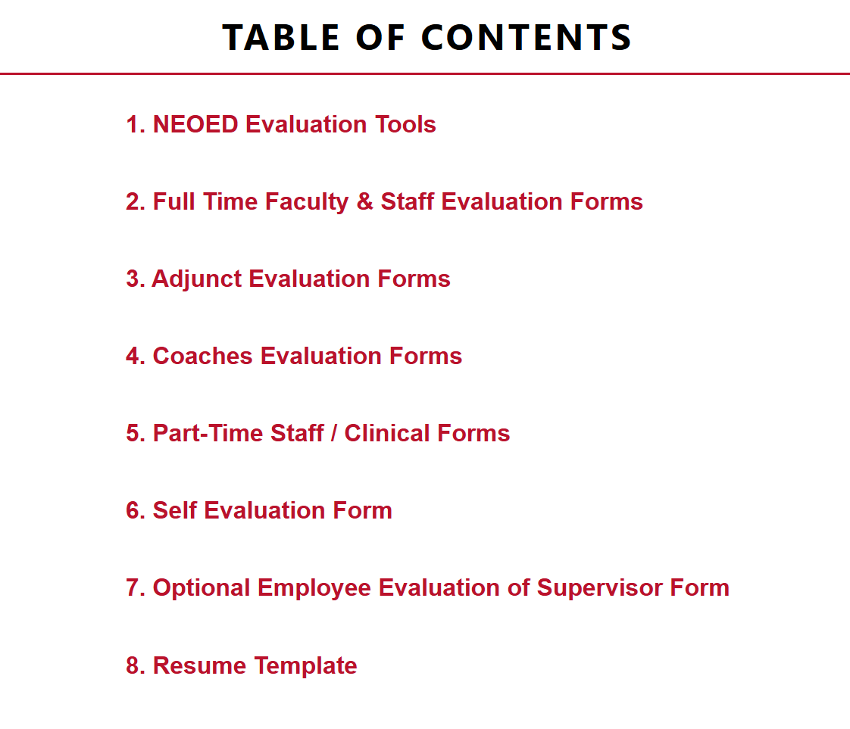
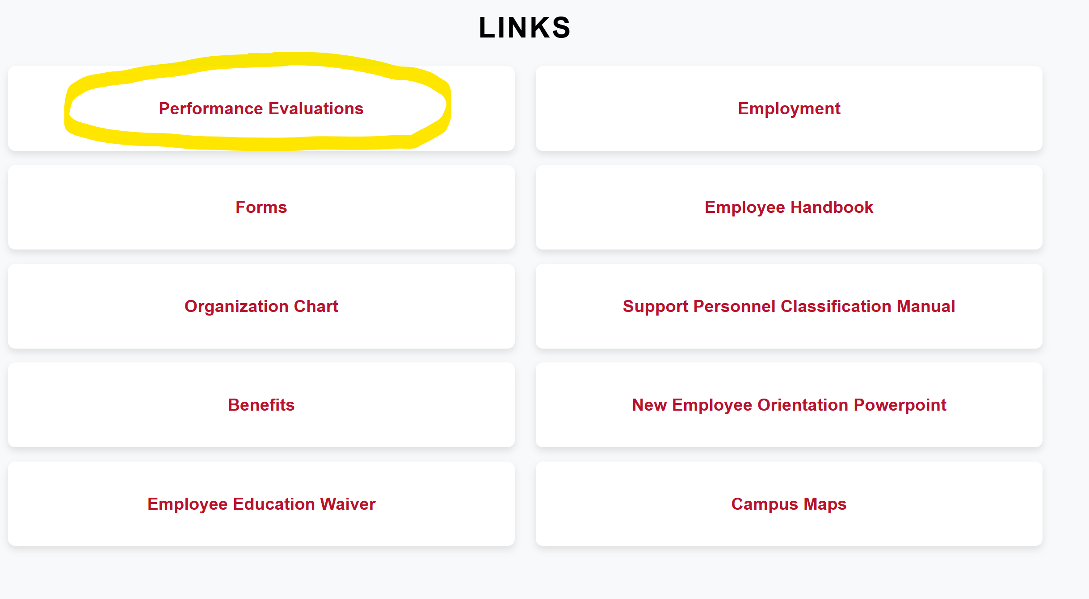
My Gadsden State Page - Forms

Slide 11
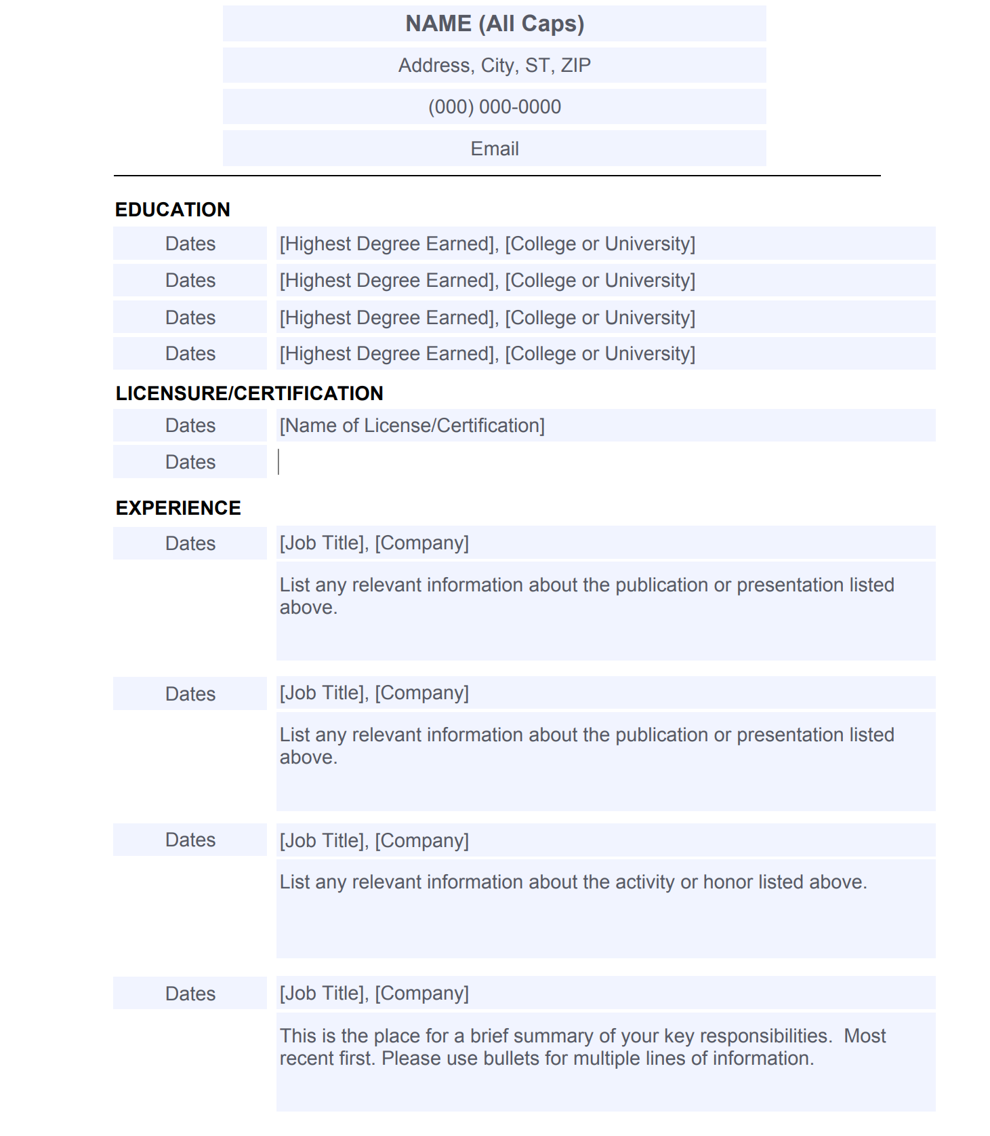
Resume
Complete it.
1
File Save With Changes to your computer
2
Last NameFirstName 022026
Upload it to NeoEd Perform by March 6 via the ‘Upload Document’ tool
3

Slide 12
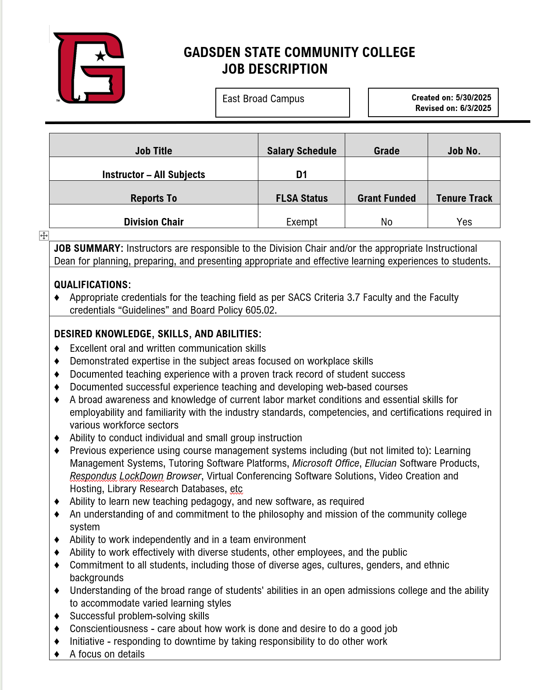
Job Description
MyGadsdenState>Departments
HumanResources>Performance Evaluations>
Job Descriptions
Search
Upload it to NeoEd Perform by 3/6 via the ‘Upload Document’ tool

Slide 13
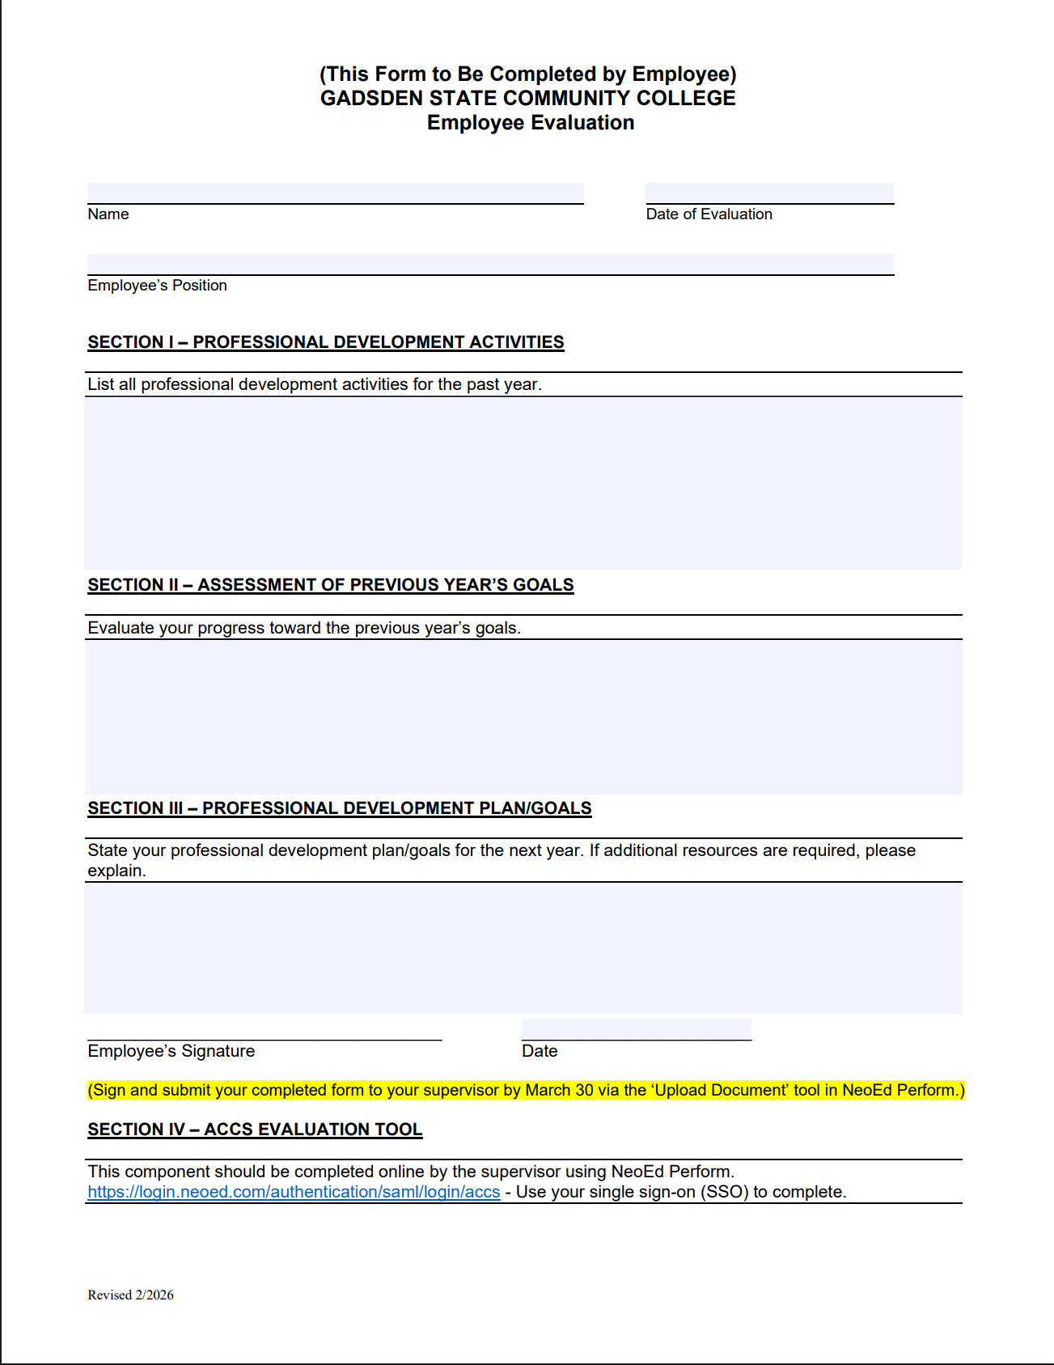
Evaluation Form
Section I – PD Activities from last year
Section II – Assessment of Previous Year’s Goals
Section III – PD Plan / Goals for next year
Sign / Date - May be filled in or digitally signed
Upload it to NeoEd Perform by 5/31 via the ‘Upload Document’ tool

Slide 14
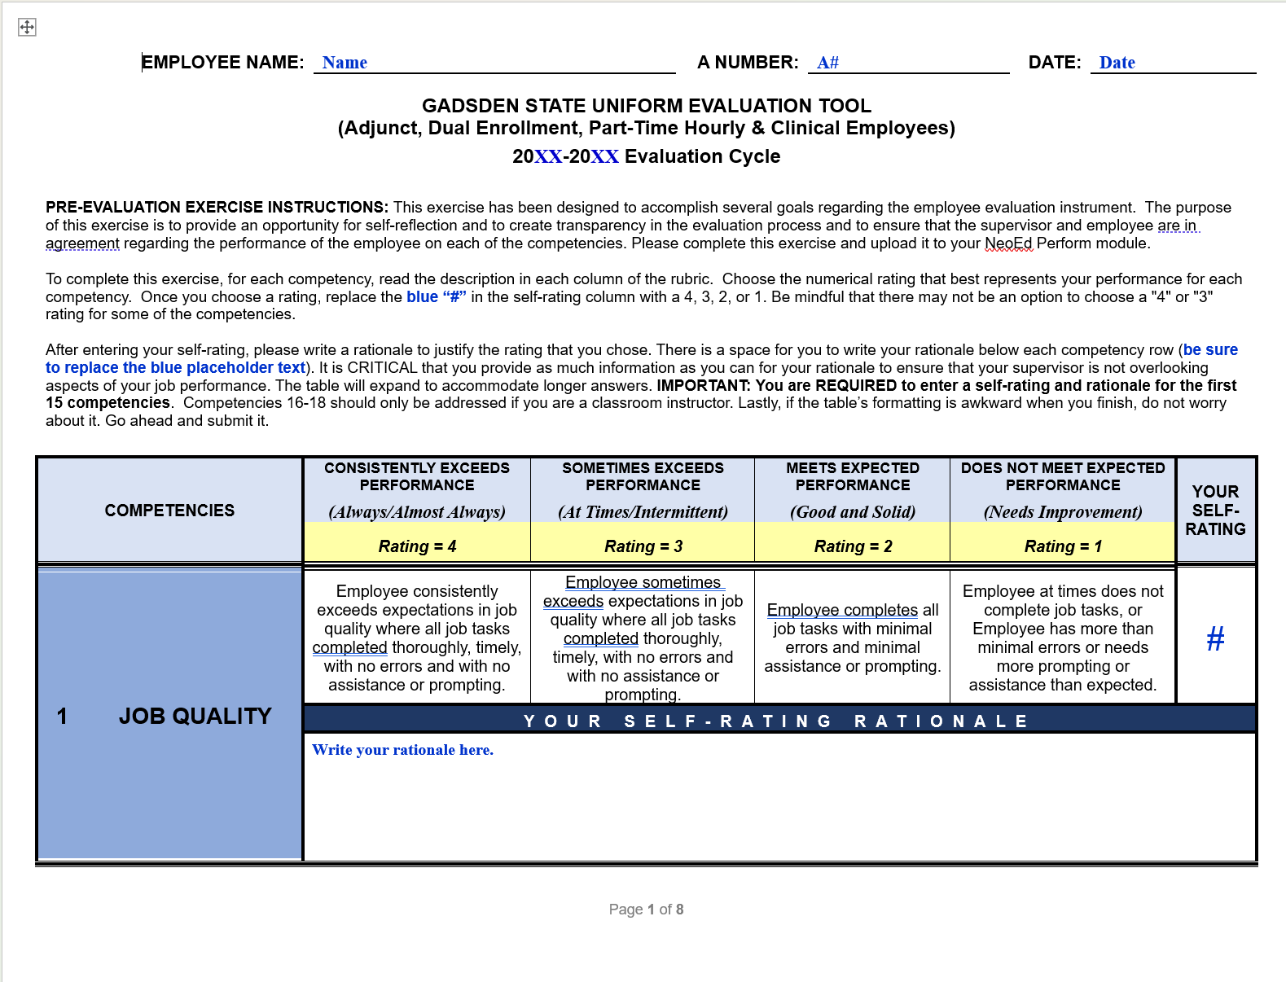
Self Assessment
Complete it
Save it as LastName First Name 032026
Upload to NeoEd Perform by March 6

Slide 15
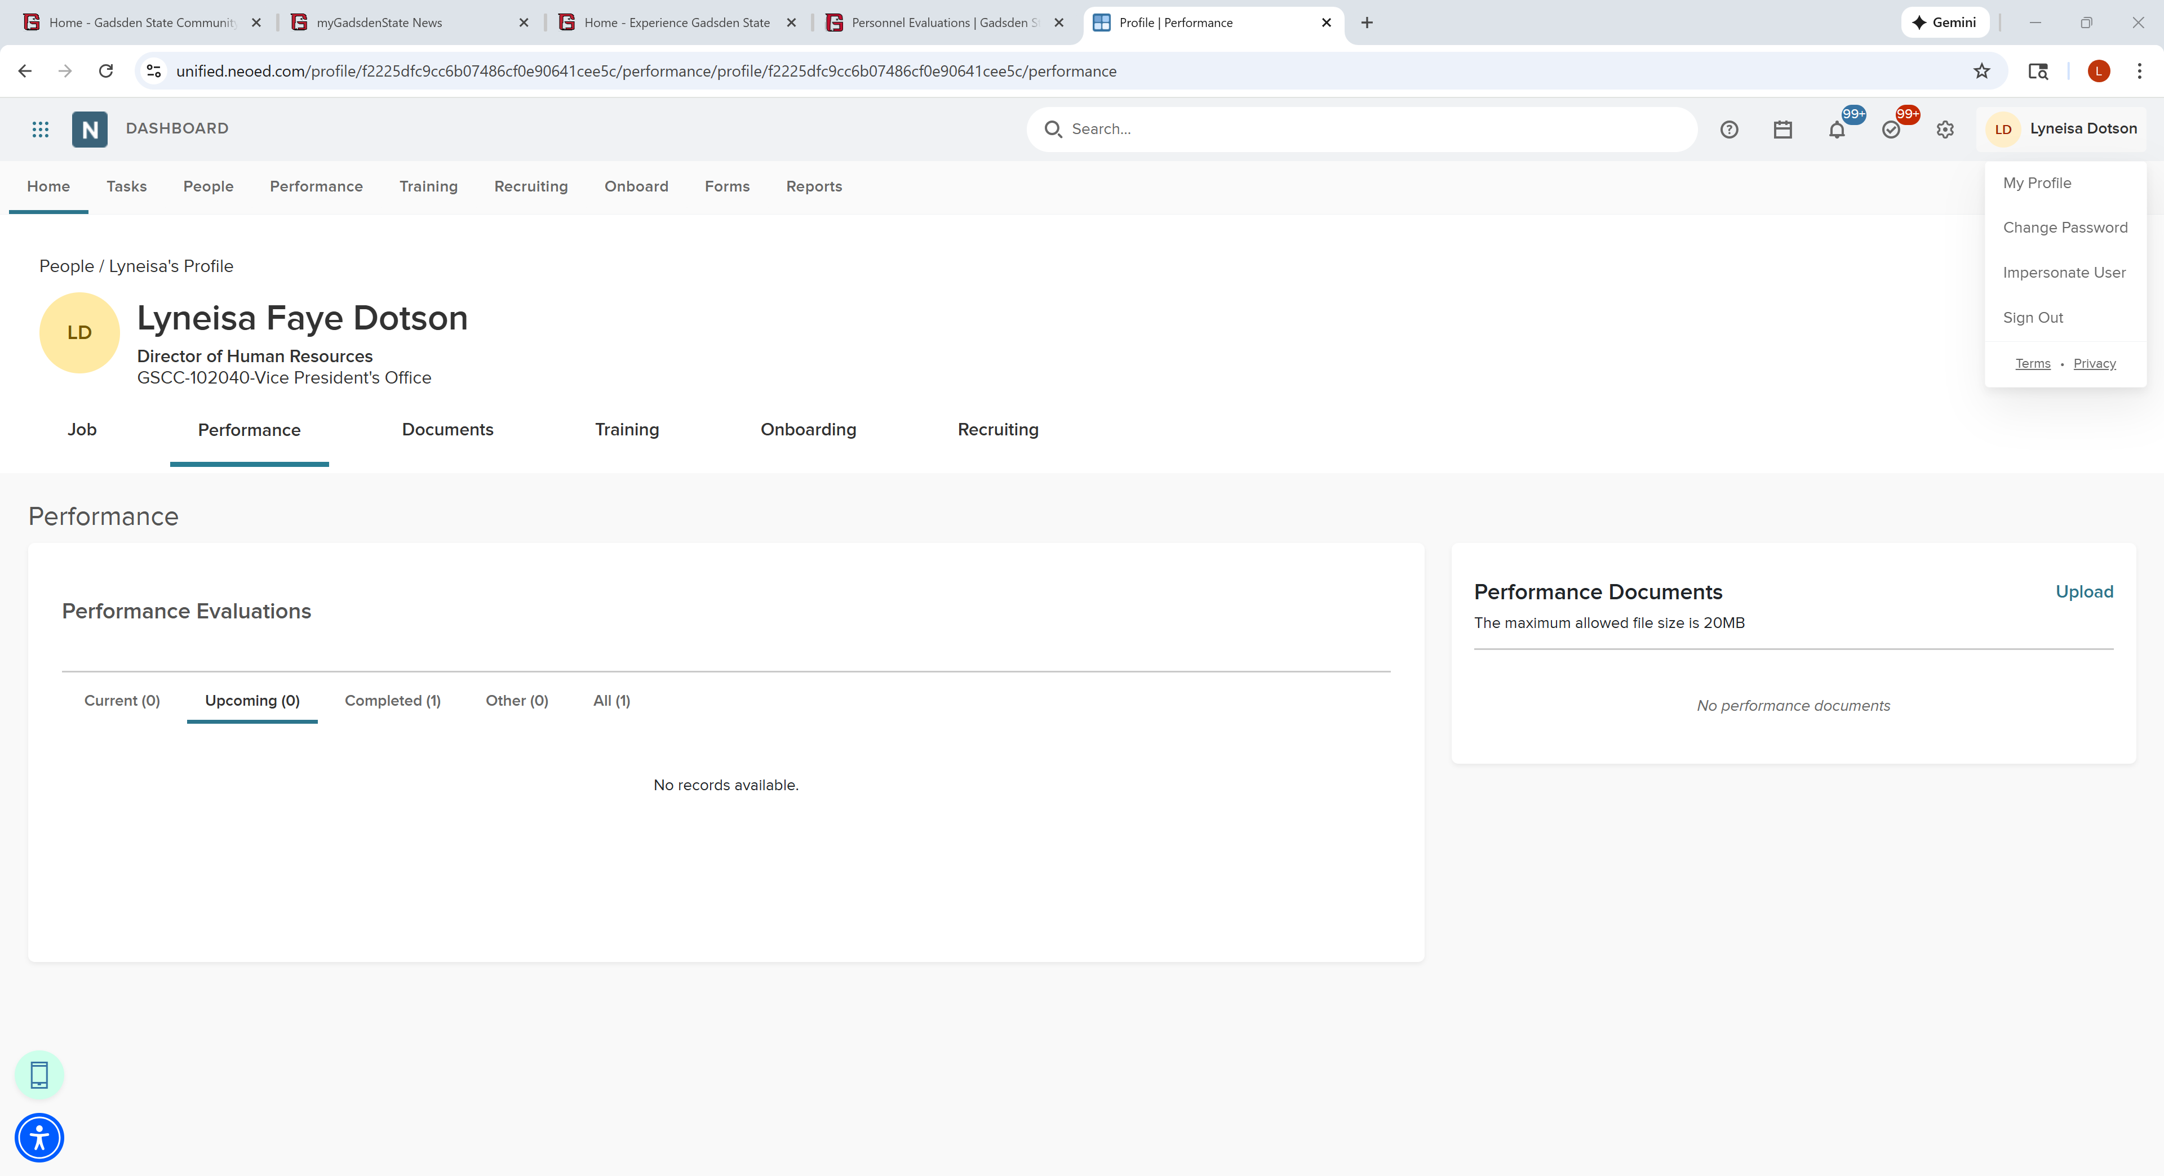
Upload Your Form to NeoEd
Click in the top right corner on your name and then ‘My Profile’
Click on the ‘Performance’ Tab
Upload your completed evaluation form to NeoEd by 5/31 via the ‘Upload’ tool
1
2
3

Slide 16
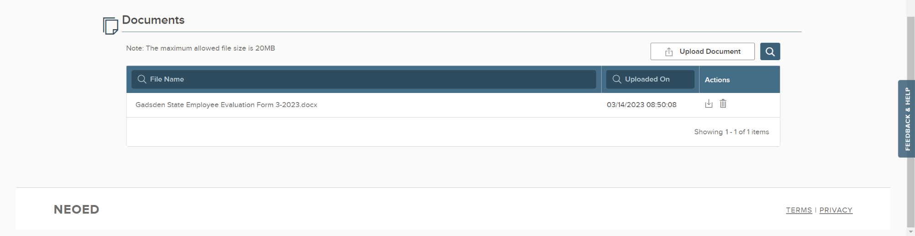
Check Your Work
Scroll to the bottom of the screen and look for the ‘Documents’ section
Look to make sure your attachment was uploaded.

Slide 17
Final Steps
Once your supervisor has completed the ACCS rating tool in NeoEd Perform, you will receive a notification
1
You will log back into NeoEd Perform to view your rating
2
Acknowledge
Refuse to Sign

Slide 18
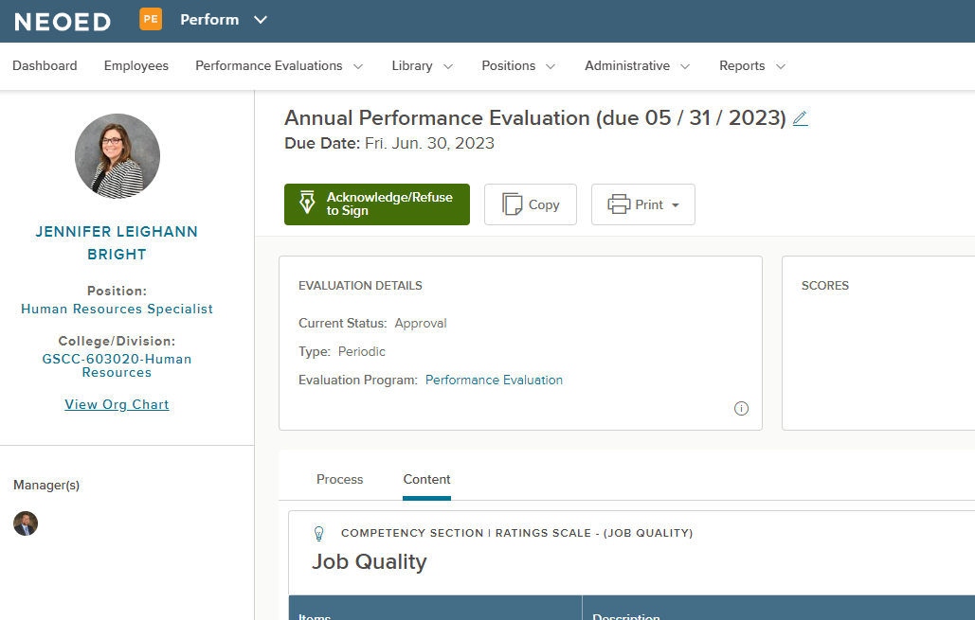
Final Steps
You may click the link from your email to view your rating in NeoEd.
From NeoEd, click the green ‘Acknowledge/Refuse to Sign’ button to advance to the comments section.

Slide 19
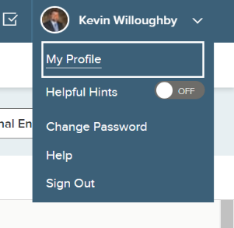
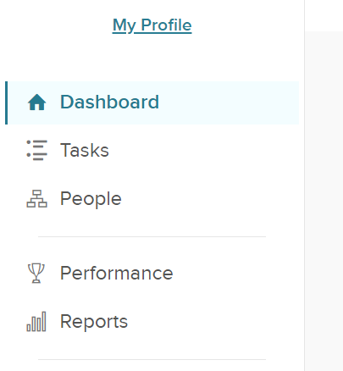
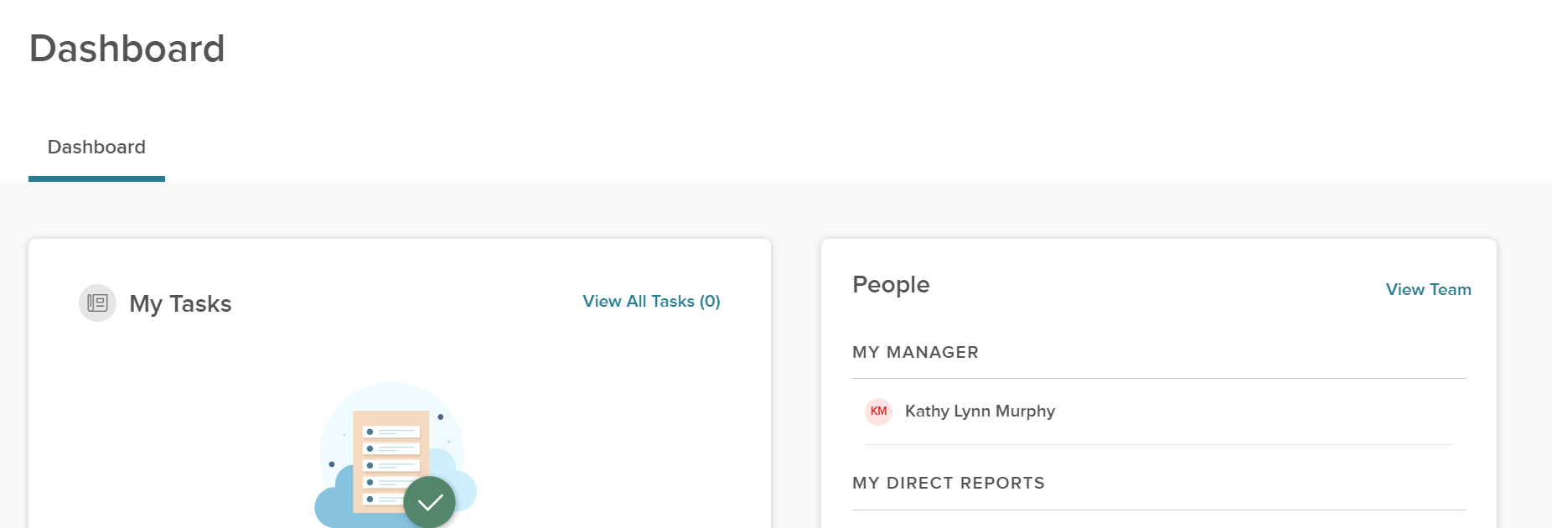
Supervisor Tasks
Check your portion of the org chart to ensure all of your full-time direct reports are listed
Click your name in the top right corner, then ‘My Profile’ and then click ‘Dashboard’ in the left pane and look for the ‘People’ section and ‘View Team’
1
2
3

Slide 20

Supervisor Tasks
Complete the ACCS Rating Tool in NeoEd
Electronic signatures by supervisor + supervisor’s supervisor
Send to employee for acknowledgement (in NeoEd)
For faculty only: Upload the Classroom Observation form to NeoEd Perform via the ‘Upload Document’ tool
You’ll receive a notification from NeoEd when the employee has completed the acknowledgement

